Slide 1

MvDad.com
Sustainable Stable Structural Solutions
Welcome
B P Karamchandani
Founder & CEO
Notes:
1

Slide 2
MvDad.com
Sustainable Stable Structural Solutions
Cloud Based RC Building Earthquake Resistant Structural Design Software.
Notes:
1

Slide 3
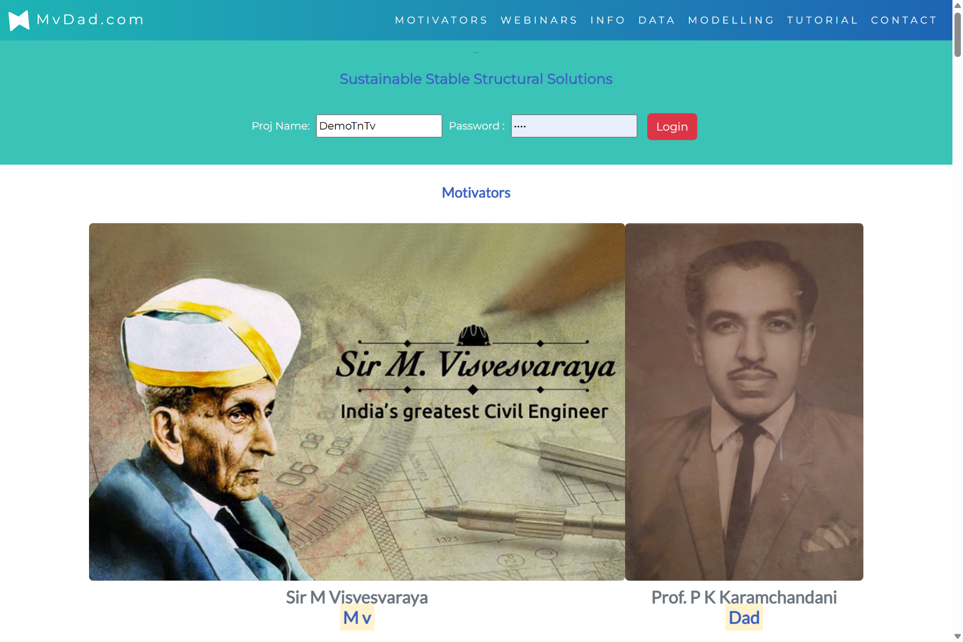
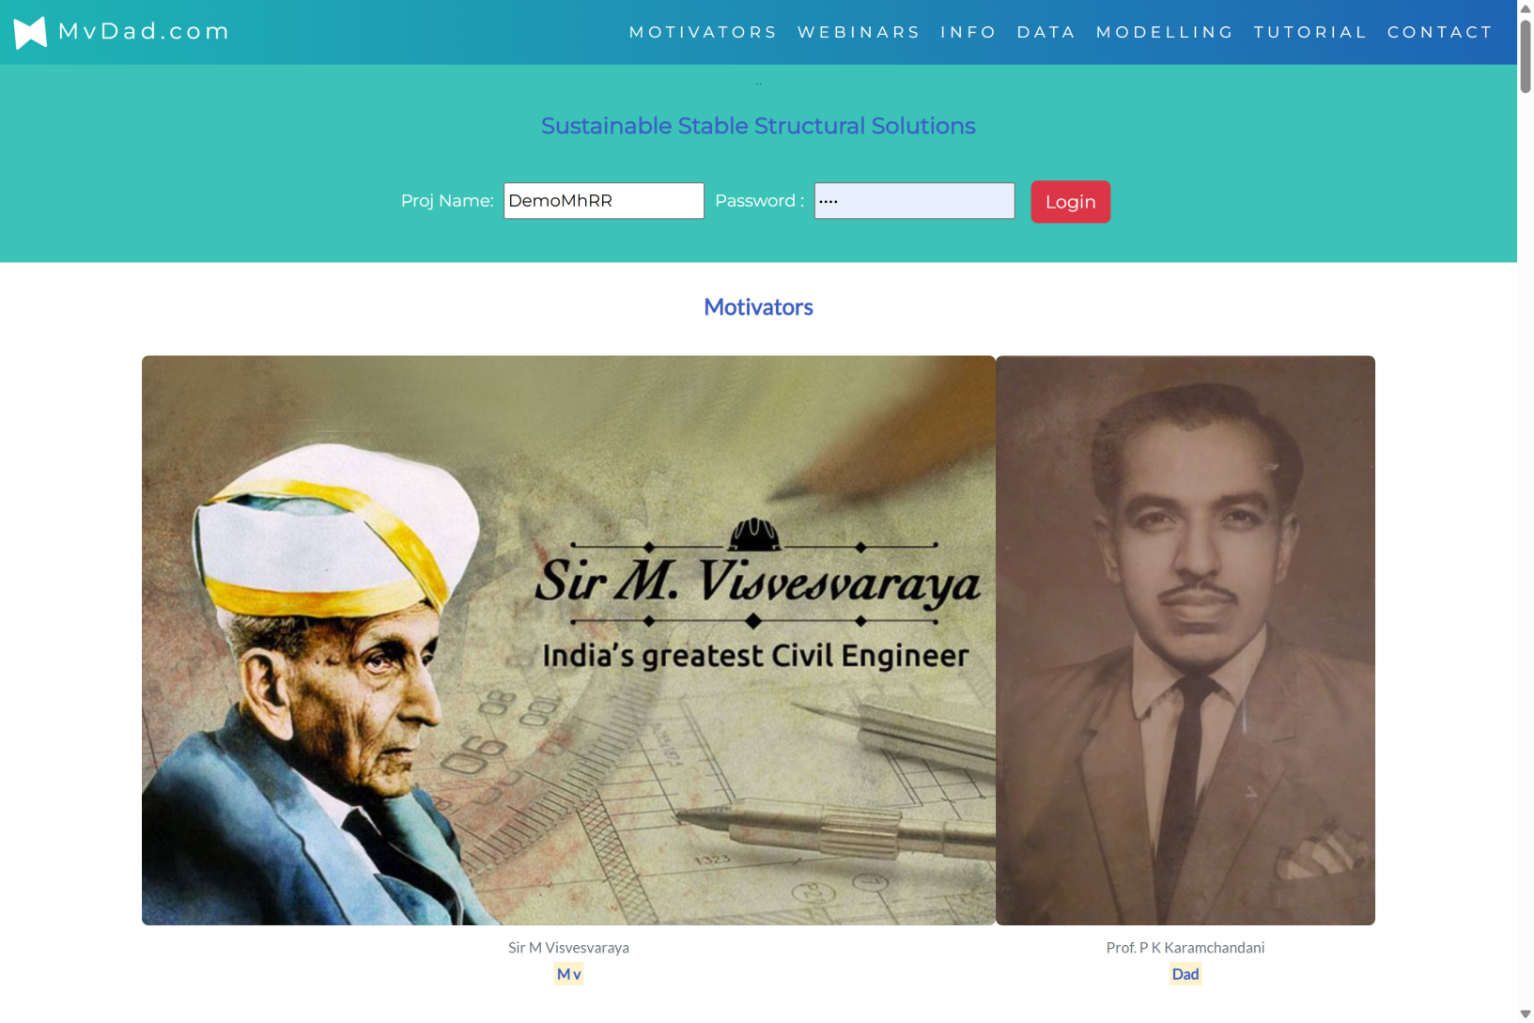
MvDad.com
Motivators
Notes:
1

Slide 4
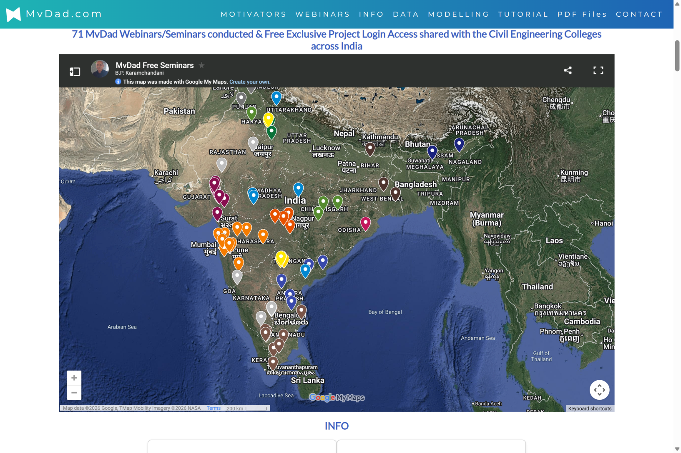
MvDad.com
74+ Seminars / Webinars
Notes:
1

Slide 5
MvDad.com
Why MvDad.com ?
Notes:
1

Slide 6
MvDad.com
Features and Benefits
Notes:
1

Slide 7
MvDad.com
Features 5 in 1
1. Analysis
  A. Gravity Loads
  Coefficient Method
  Fixed End Moments
  2D and 3D Frame Analysis
  Finite Element Analysis
  To check Strength
Notes:
1

Slide 8
MvDad.com
Features 5 in 1
1. Analysis
  A. Gravity Loads B. Seismic Loads
  Coefficient Method a. Static Equivalent Coefficient Method
  Fixed End Moments b. Dynamic Response Spectrum Method
  2D and 3D Frame Analysis ABS Method: Absolute Sum Method
  Finite Element Analysis SRSS Method: Square root of Sum of Squares
  CQC Method: Complete Quadratic Combination
  To check Strength To check Structure Stability, Drift & Displacement
  by P-Delta Method
Notes:
1

Slide 9
MvDad.com
Features 5 in 1
2. Design
  To Design the Most Economical Section Each and every element is OPTIMISED By reiterating.
  Footing, Column, R Beam, Flanged Beam, Slab
  Economical Beam Design on the basis of Bending Moment at the Face of the Column.
To make Sustainable Stable Structure.
Notes:
1

Slide 10
MvDad.com
Features 5 in 1
3. Drawings
  Plan, Elevation, Sectional Elevation, 3D.
  A. SFD & BMD for DL / LL
  B. Reinforcement Detail Drawings of All the Elements. Footing, Column, Beam, Slab
  C. Centre of Gravity, Centre of Mass , Torsion Floor wise, Shear Force & Lateral Force
  D. Displacement, Inter storey Drift & Stability
To Visulise the Results in Graphic Format.
Notes:
1

Slide 11
MvDad.com
Features 5 in 1
4. Calculations
  Detail step by step Calculations for education purpose.
To understand how the Analysis, & Design is carried out as per IS Codes.
Notes:
1

Slide 12
MvDad.com
Features 5 in 1
5. Bill of Quantiy
  Cement: Element wise, Grade wise, Module wise, Floor wise.
  Steel Reinforcement: Element wise, Grade wise, Module wise, Floor wise & Dia wise.
To Get the Estimation at the beginning of the Work.
Notes:
1

Slide 13
MvDad.com
Features 5 in 1
1. Analysis
2. Design
3. Drawings
4. Caculations
5. Bill of Quantities
Notes:
1

Slide 14
MvDad.com
Benefits
Notes:
1

Slide 15
MvDad.com
Benefits
  1. Manpower:
  Draftsman for Drawing Not required
  Professional Engineer for
  Analysis Not required
  Design Not required
  Detail Drawing Not required
  Bill of Quantities Not required
No Manpower Required.
Notes:
1

Slide 16
MvDad.com
Benefits
2. Tools:
  A. Software
  Operating Software Not required
  Drawing Software Not required
  Analysis Software Not required
  Design Software Not required
  RC Detail Drawing Software Not required
  Bill of Quantities Software Not required
  B. Hardware
  Specific Hardware Not Required
No Tools Required.
Notes:
1

Slide 17
MvDad.com
Benefits
3. Freedom:
Work from Anywhere On Smart Mobile
        A. Multi Access
        B. Multi Users
        C. Multi Location
Cloud Based
Notes:
1

Slide 18
MvDad.com
Benefits
4. Green Revolution :
Environment Friendly PAPER LESS
Sustainable
Notes:
1

Slide 19
MvDad.com
Benefits
5. Modelling:
    Dynamic Auto Modelling on Principals of Basic IS Codes Fundaments.
    Machine Learning of Frame Analysis and Design
Auto Modelling.
Notes:
1

Slide 20
MvDad.com
Benefits
6. Safe:
    EARTHQUAKE Resistant
    Sustainable Stable Structural Solutions.
To Save Precious Human Lives.
Notes:
1

Slide 21
MvDad.com
Benefits
7. Avialability:
            24 X 7
            365 days
To Save Precious Time.
Notes:
1

Slide 22
MvDad.com
Benefits
8. Results:
    Transparent RESULTS along with Entered Data in MS Excel & Graphic Format
To Execute Work Smoothly.
Notes:
1

Slide 23
MvDad.com
Benefits
9. Cost:
      Saving on
      Trained Manpower
      Expensive software
      Computer Hardware
Pay per use.
Notes:
1

Slide 24
MvDad.com
How to Operate MvDad.com ?
Notes:
1

Slide 25
MvDad.com
Create New Project
Notes:
1

Slide 26
MvDad.com
Create New Project
Select 6 Data from the DropDown Box
Notes:
1

Slide 27
MvDad.com
Create New Project
Select 6 Data from the DropDown Box
1. Building Type
Notes:
1

Slide 28
MvDad.com
Create New Project
Select 6 Data from the DropDown Box
Building Type
Number of Floors
Notes:
1

Slide 29
MvDad.com
Create New Project
Select 6 Data from the DropDown Box
Building Type
Number of Floors
Floor Heights
Notes:
1

Slide 30
MvDad.com
Create New Project
Select 6 Data from the DropDown Box
Building Type
Number of Floors
Floor Heights
Project Location
Notes:
1

Slide 31
MvDad.com
Create New Project
Select 6 Data from the DropDown Box
Building Type
Number of Floors
Floor Heights
Project Location
Foundation Depth
Notes:
1

Slide 32
MvDad.com
Create New Project
Select 6 Data from the DropDown Box
Building Type
Number of Floors
Floor Heights
Project Location
Foundation Depth
Soil Type
Notes:
1

Slide 33
MvDad.com
Create New Project
Select 6 Data from the DropDown Box
Building Type
Number of Floors
Floor Heights
Project Location
Foundation Depth
Soil Type
1 Data to be Entered
Notes:
1

Slide 34
MvDad.com
Create New Project
Select 6 Data from the DropDown Box
Building Type
Number of Floors
Floor Heights
Project Location
Foundation Depth
Soil Type
1 Data to be Entered
Bearing Capacity of Soil
Notes:
1

Slide 35
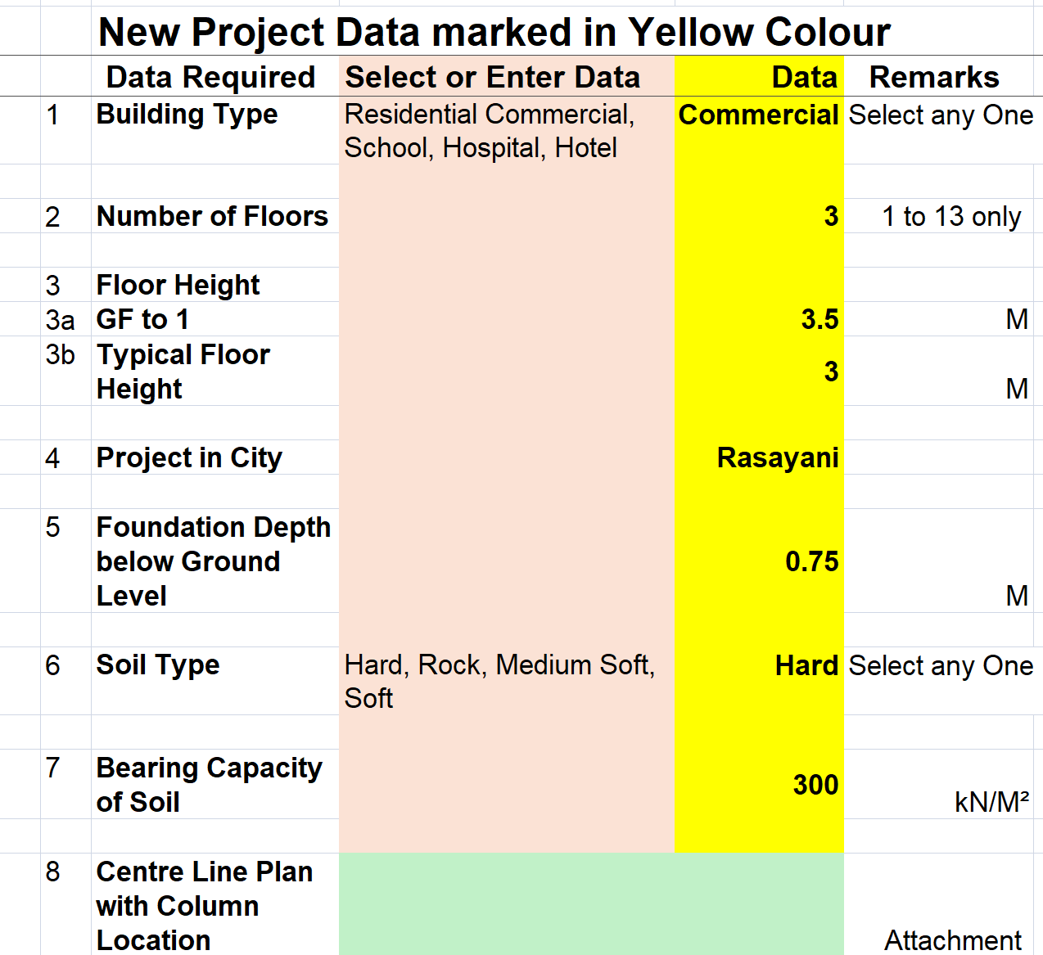
MvDad.com
New Project Data Sheet
Notes:
1

Slide 36
MvDad.com
Create New Project
Upload the Center Line Plan along with Column Locations
Notes:
1

Slide 37
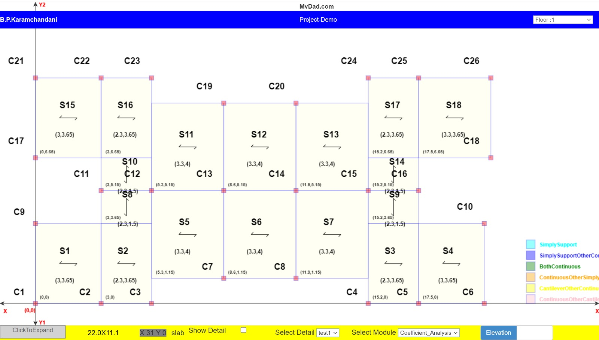
MvDad.com
Center Line Plan with Column Locations
Notes:
1

Slide 38
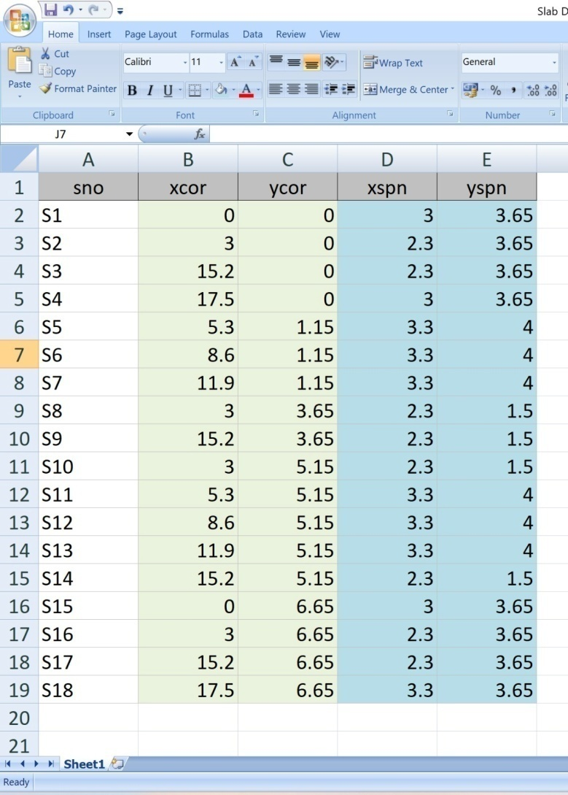
MvDad.com
Or Upload Slab Data in Excel Format
Notes:
1

Slide 39
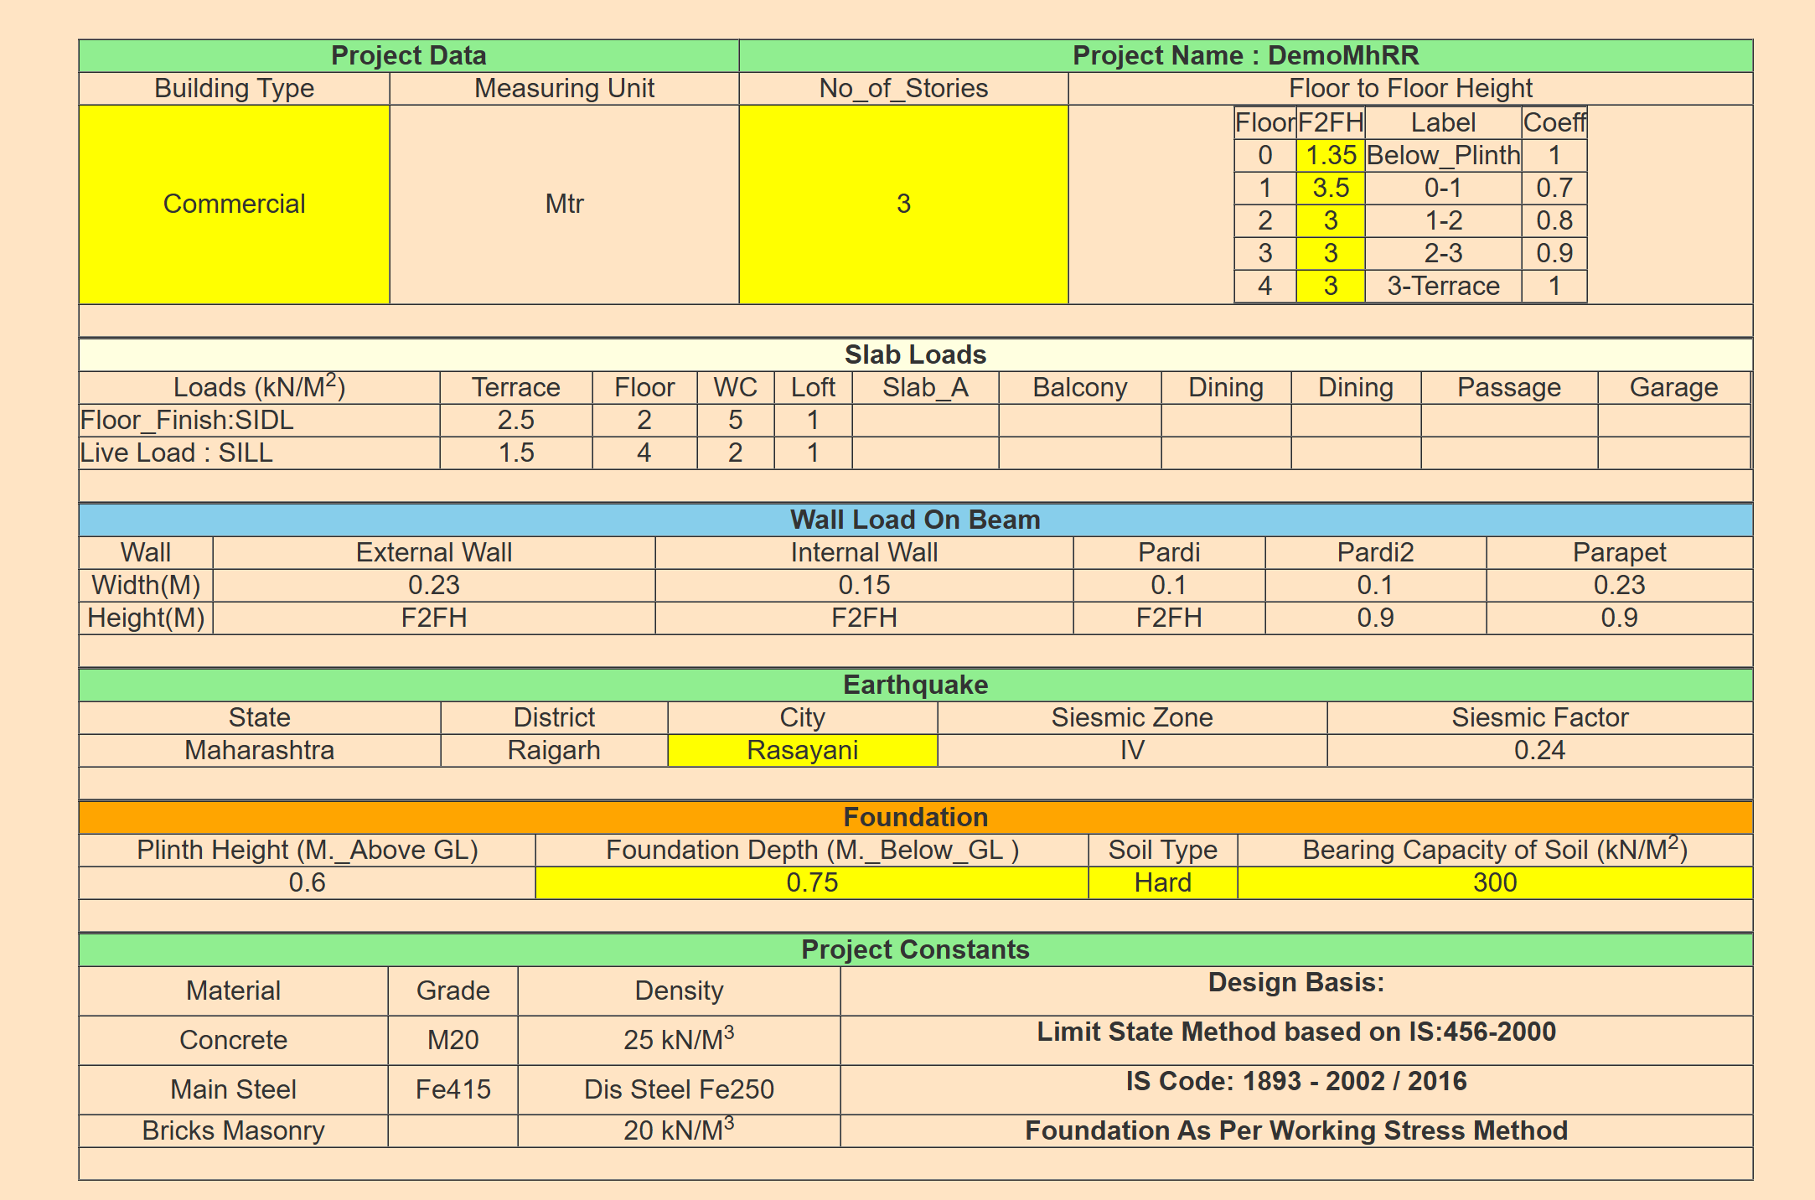
MvDad.com
New Project Data as Entered
Notes:
1

Slide 40
MvDad.com
Modelling
Notes:
1

Slide 41
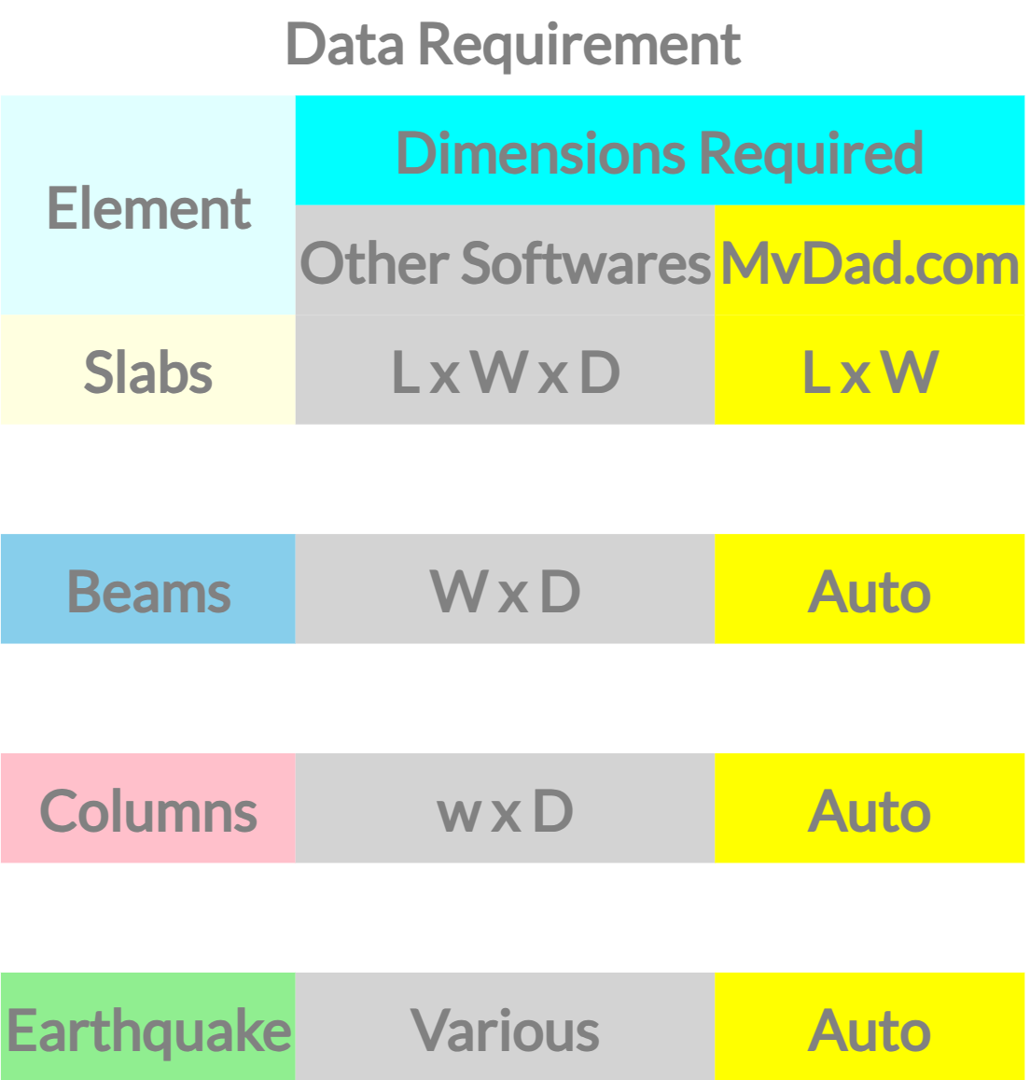
MvDad.com
Modelling Data
Notes:
1

Slide 42
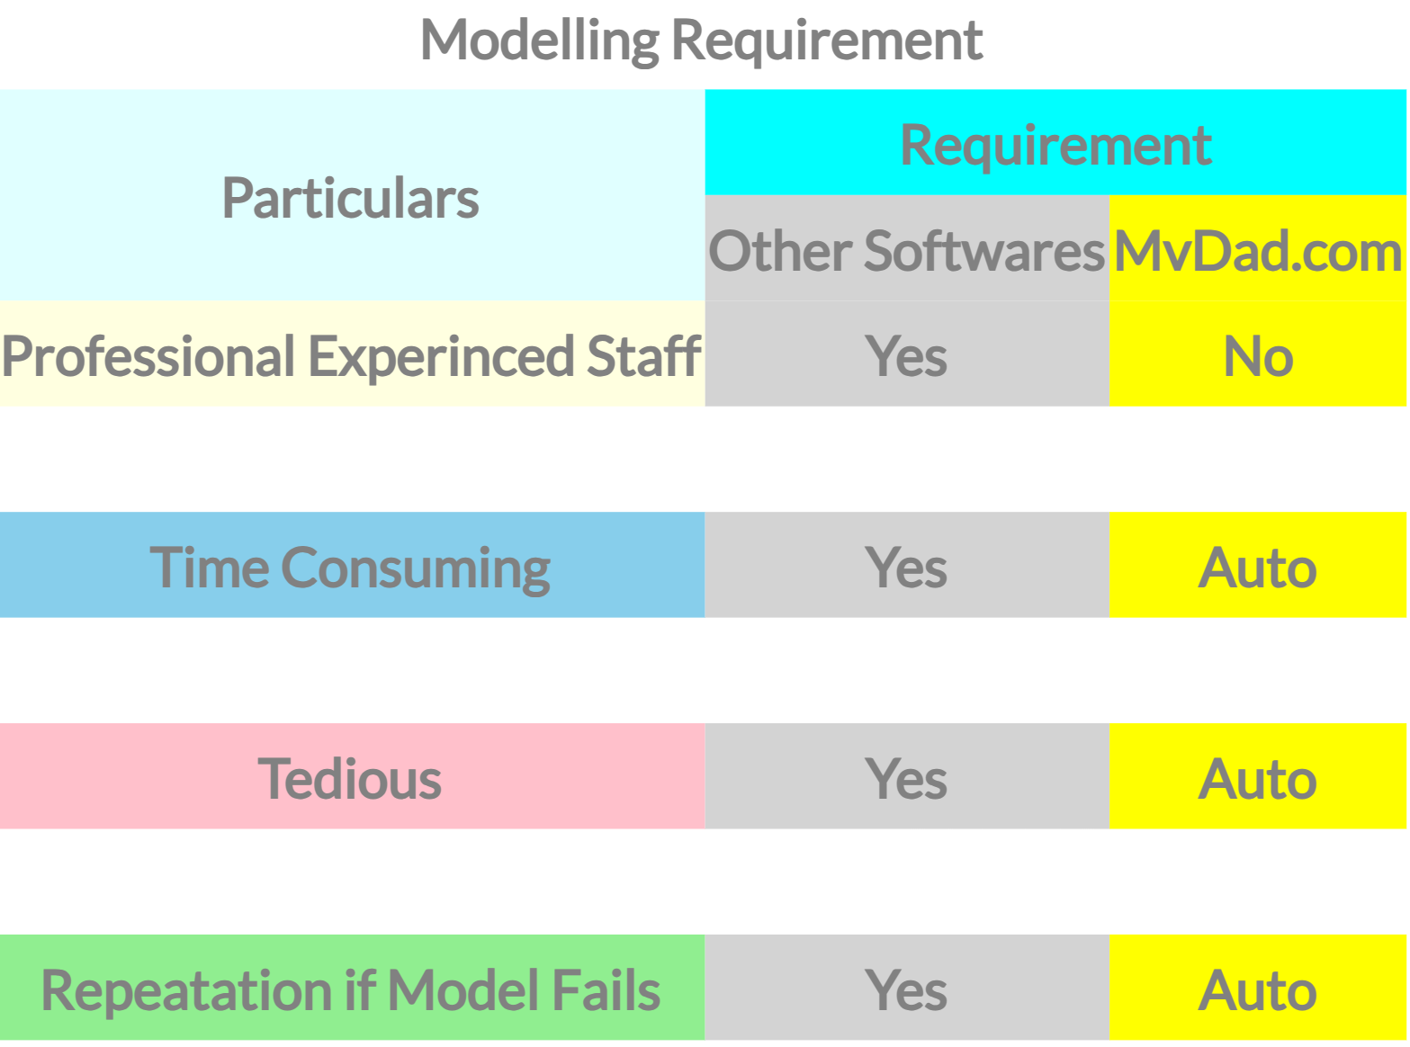
MvDad.com
Modelling Requirement
Notes:
1

Slide 43
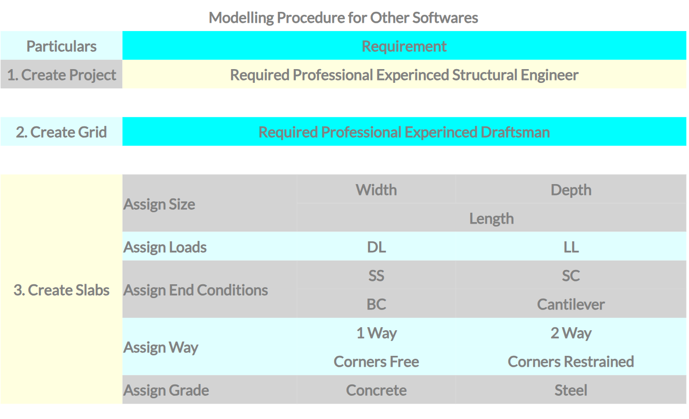
MvDad.com
Modelling Procedure
Notes:
1

Slide 44
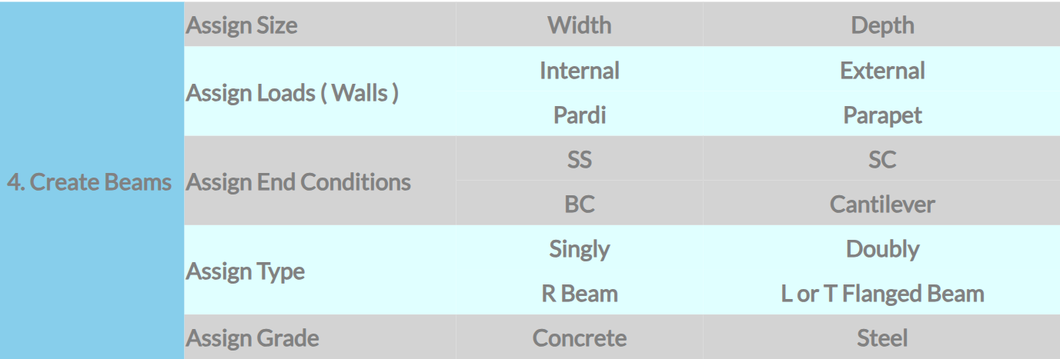
MvDad.com
Modelling Procedure
Notes:
1

Slide 45
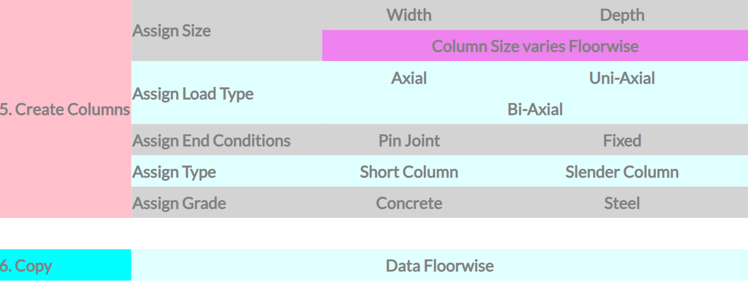
MvDad.com
Modelling Procedure
Notes:
1

Slide 46
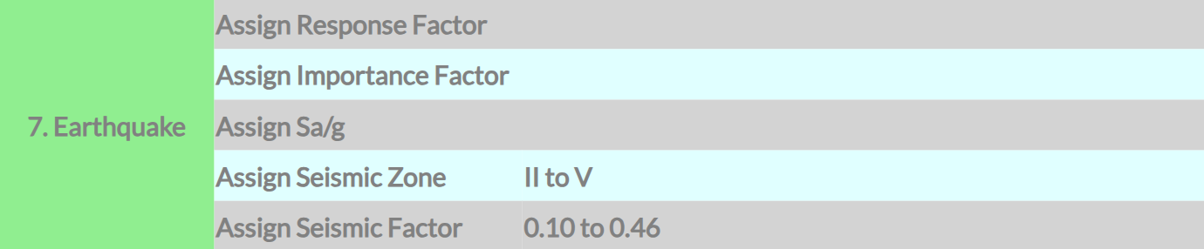
MvDad.com
Modelling Procedure
Notes:
1

Slide 47
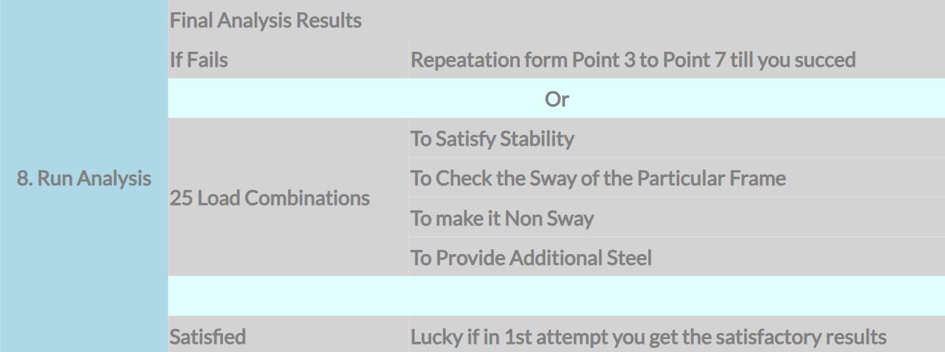
MvDad.com
Modelling Procedure
Notes:
1

Slide 48
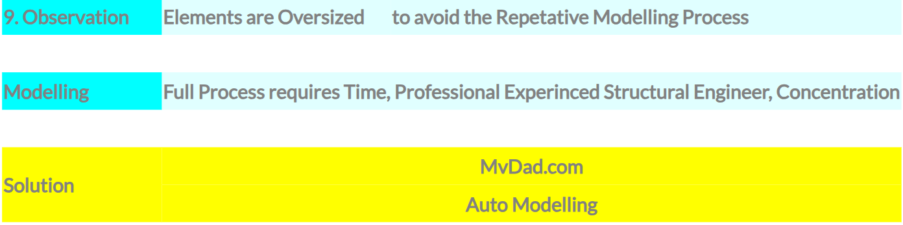
MvDad.com
Modelling Procedure
Notes:
1

Slide 49
MvDad.com
Modelling
Auto Modelling
Notes:
1

Slide 50
MvDad.com
Optimisation
Optimise Steel Design
Notes:
1

Slide 51
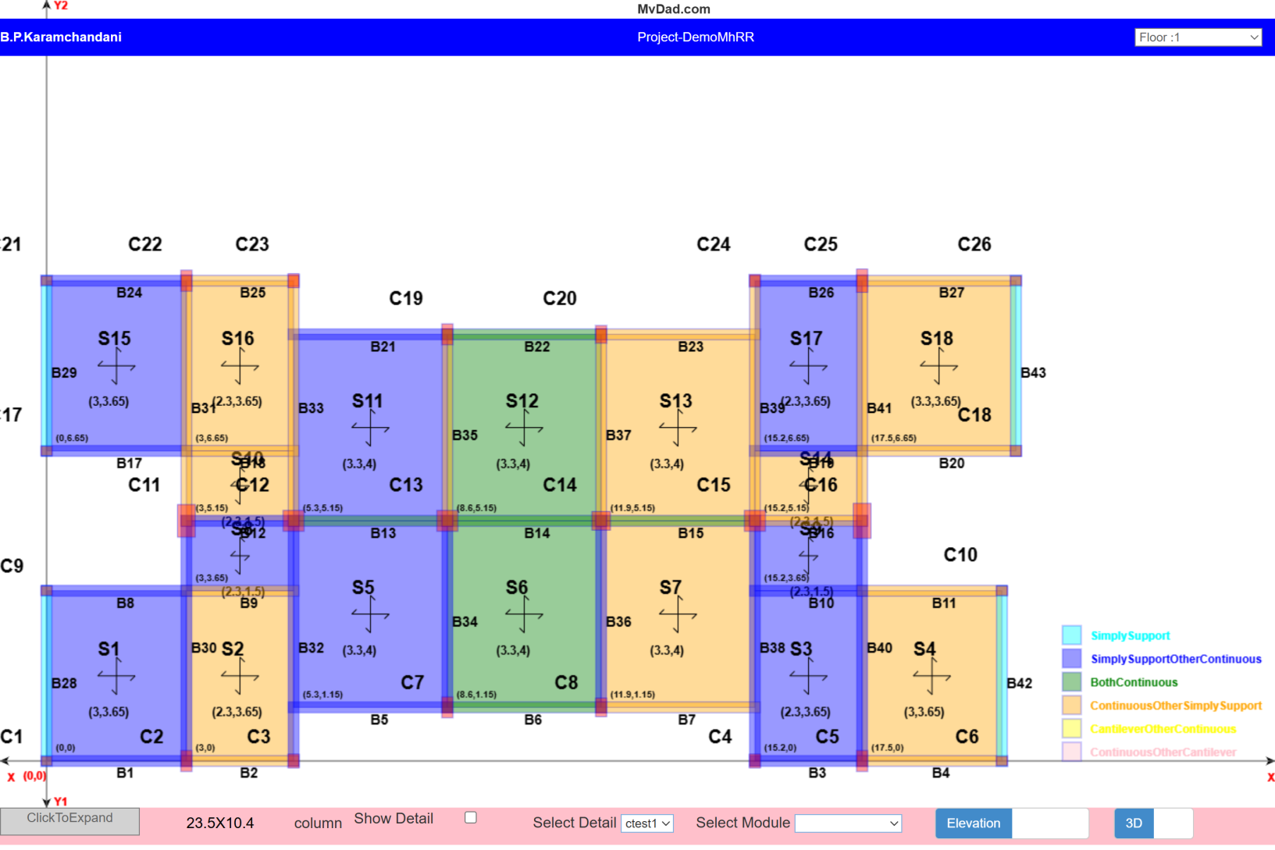
MvDad.com
Plan
Notes:
1

Slide 52
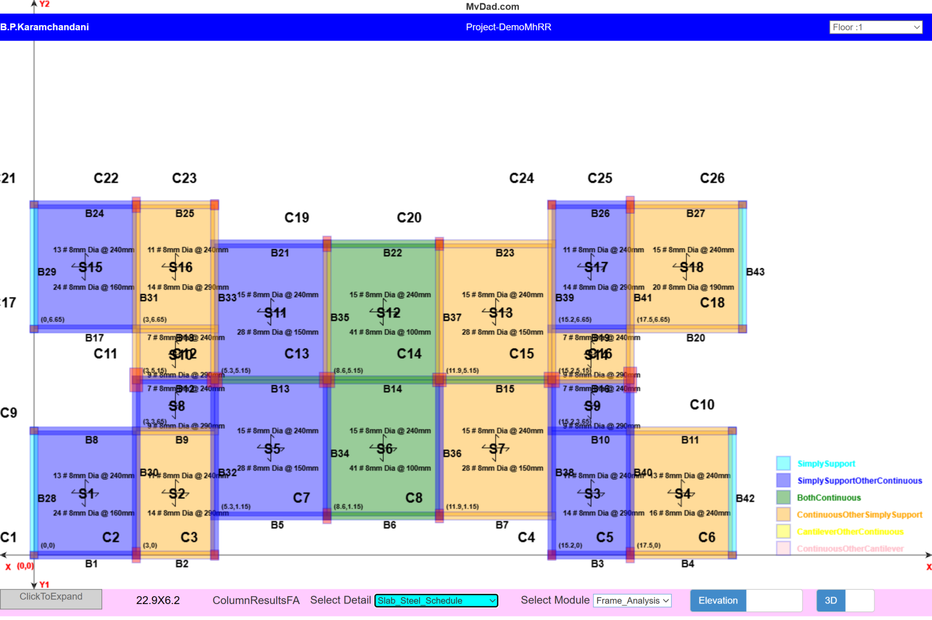
MvDad.com
Slab Steel Design
Notes:
1

Slide 53
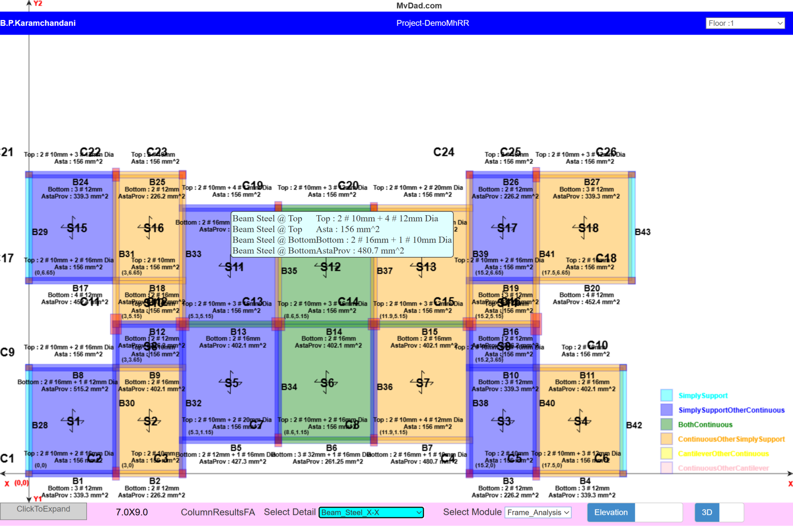
MvDad.com
Beam Steel Design
Notes:
1

Slide 54
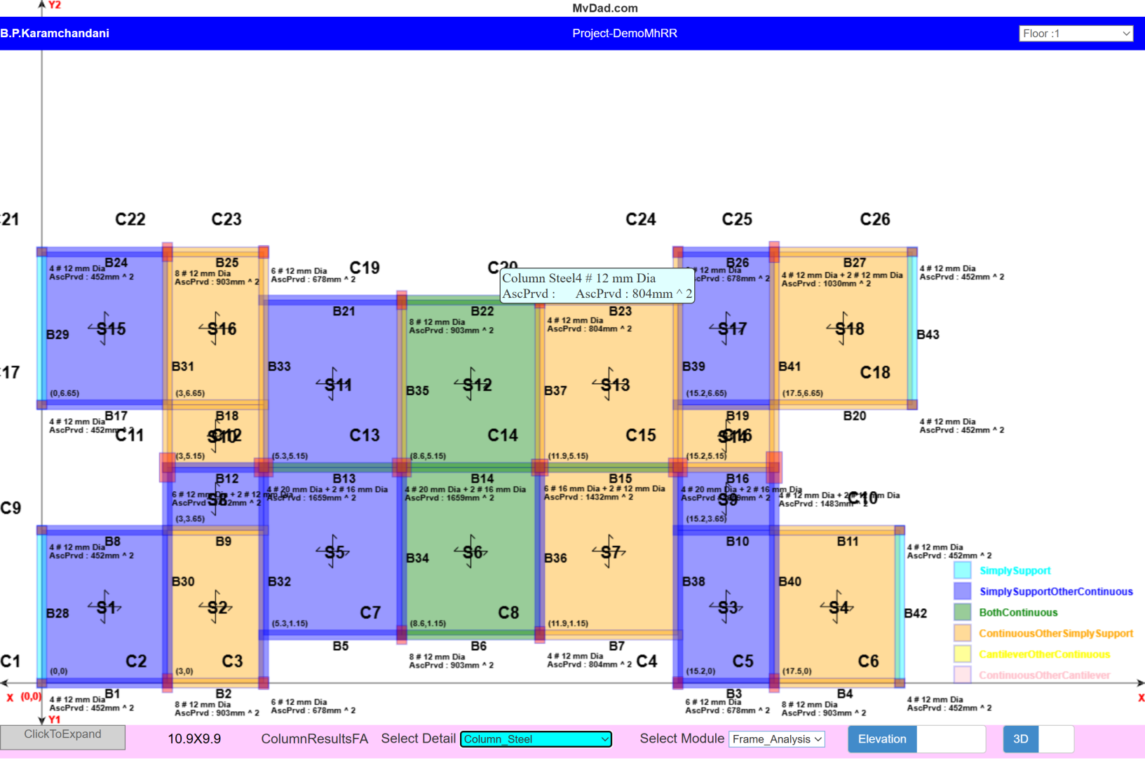
MvDad.com
Column Steel Design
Notes:
1

Slide 55
MvDad.com
Drawings
Notes:
1

Slide 56
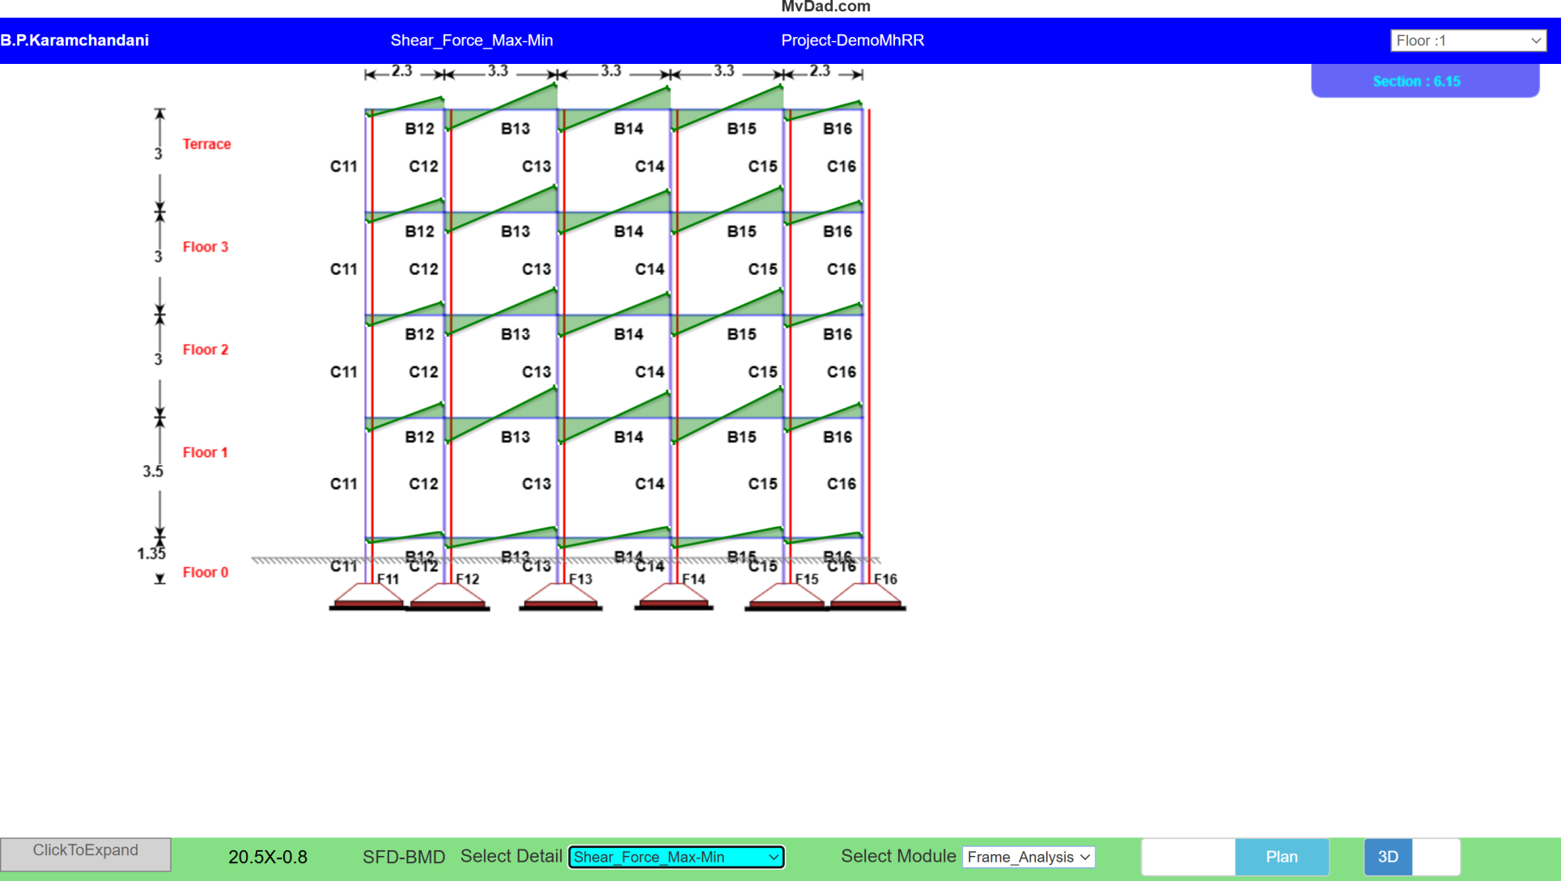
MvDad.com
Shear Force Diagram
Notes:
1

Slide 57
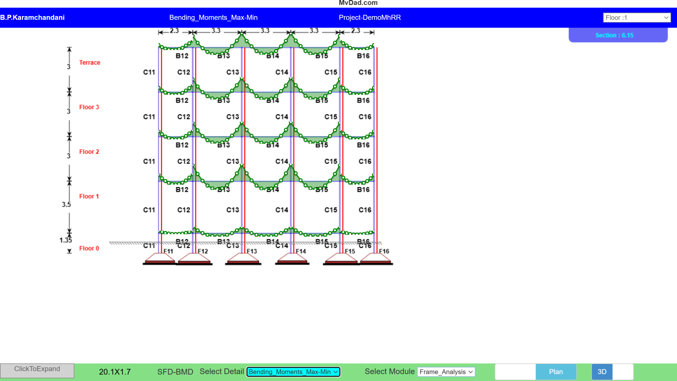
MvDad.com
Bending Moment Diagram
Notes:
1

Slide 58
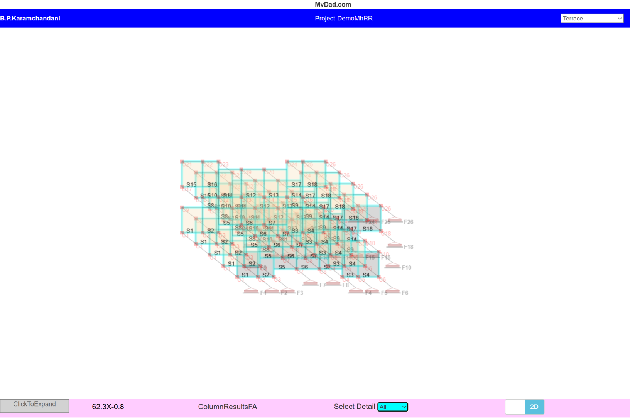
MvDad.com
3 D
Notes:
1

Slide 59
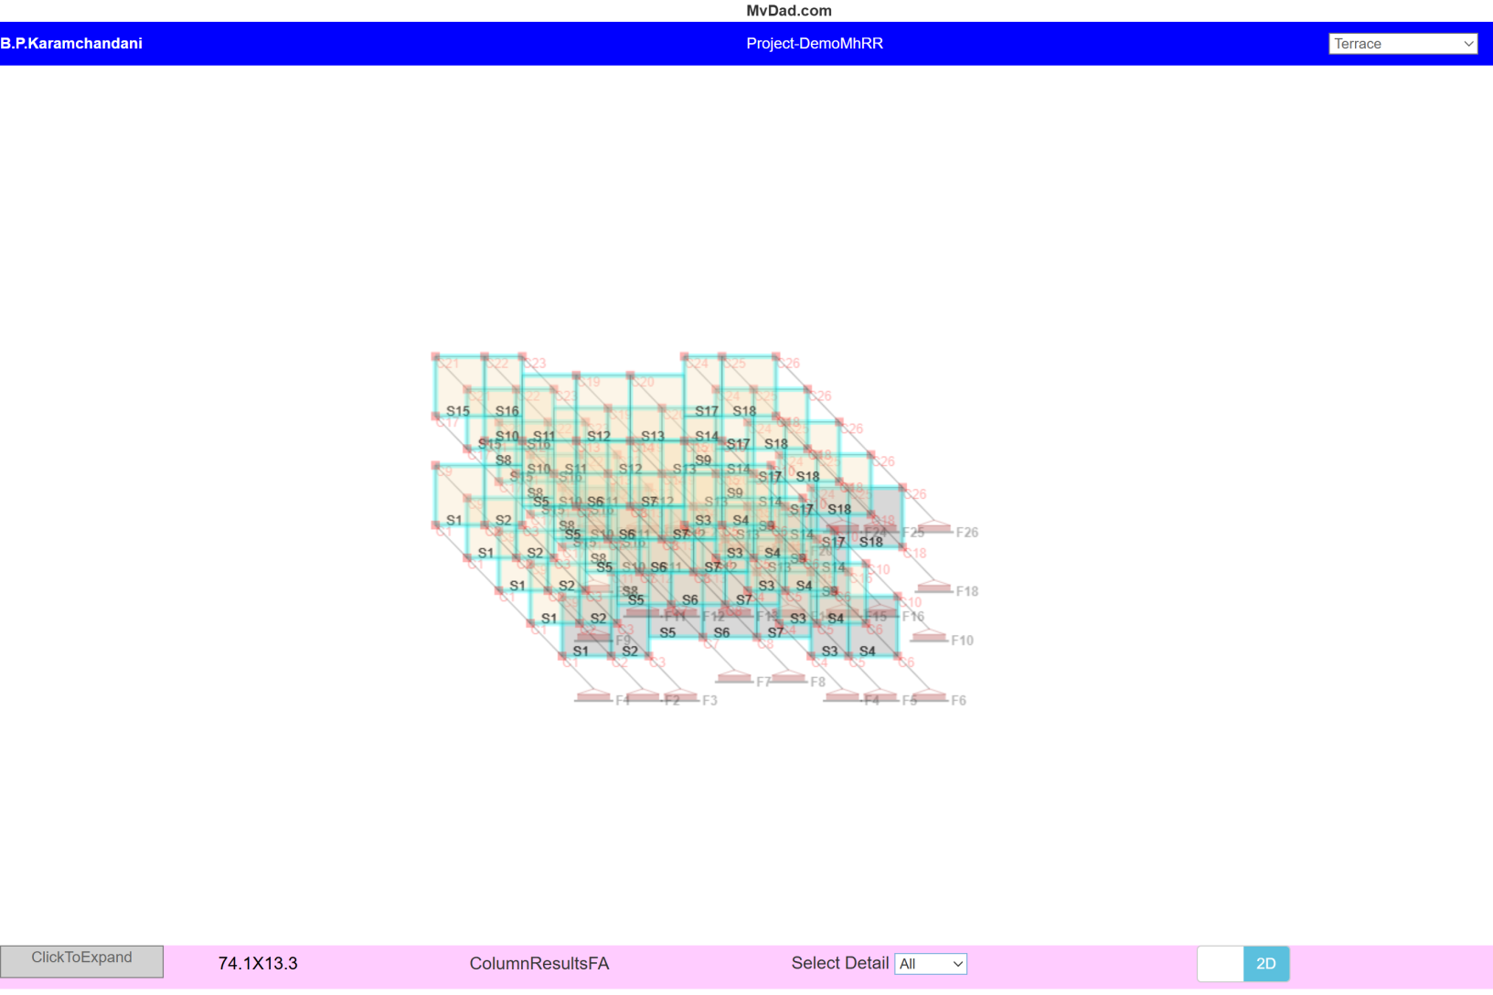
MvDad.com
3 D
Notes:
1

Slide 60
MvDad.com
Steel Drawings
Notes:
1

Slide 61
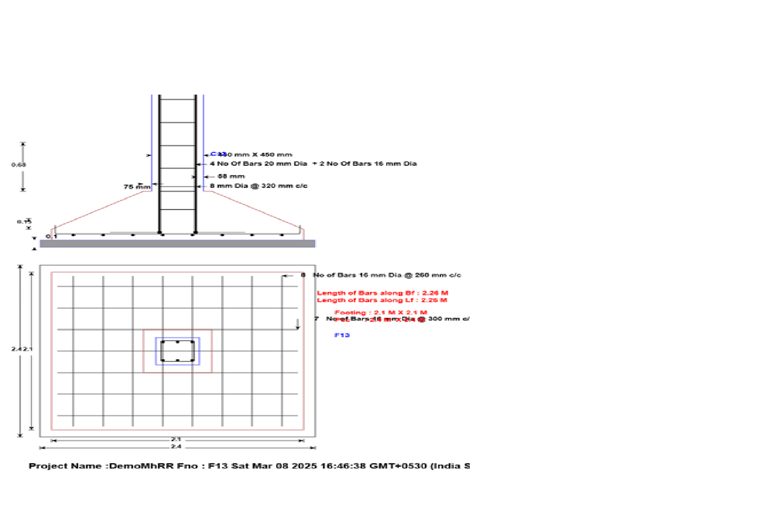
MvDad.com
Footing
Notes:
1

Slide 62
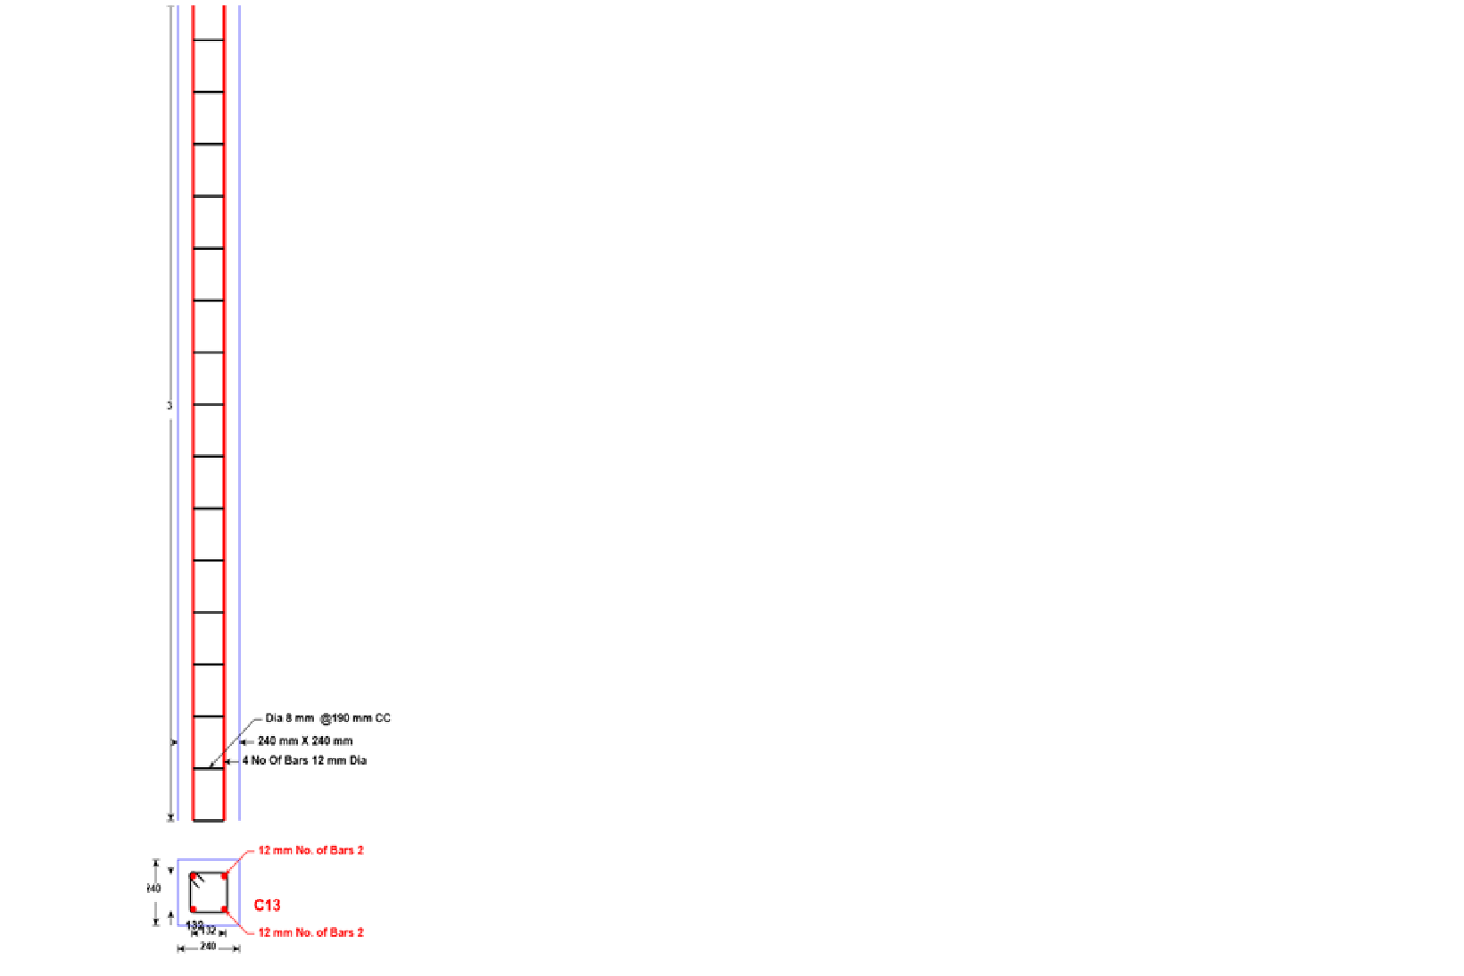
MvDad.com
Column
Notes:
1

Slide 63
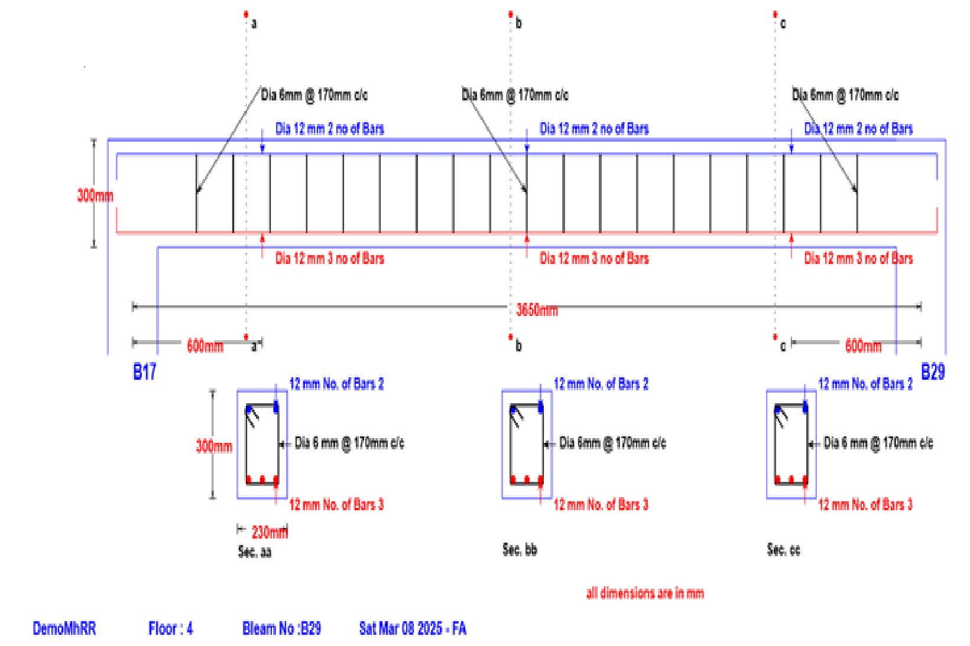
MvDad.com
Beam
Notes:
1

Slide 64
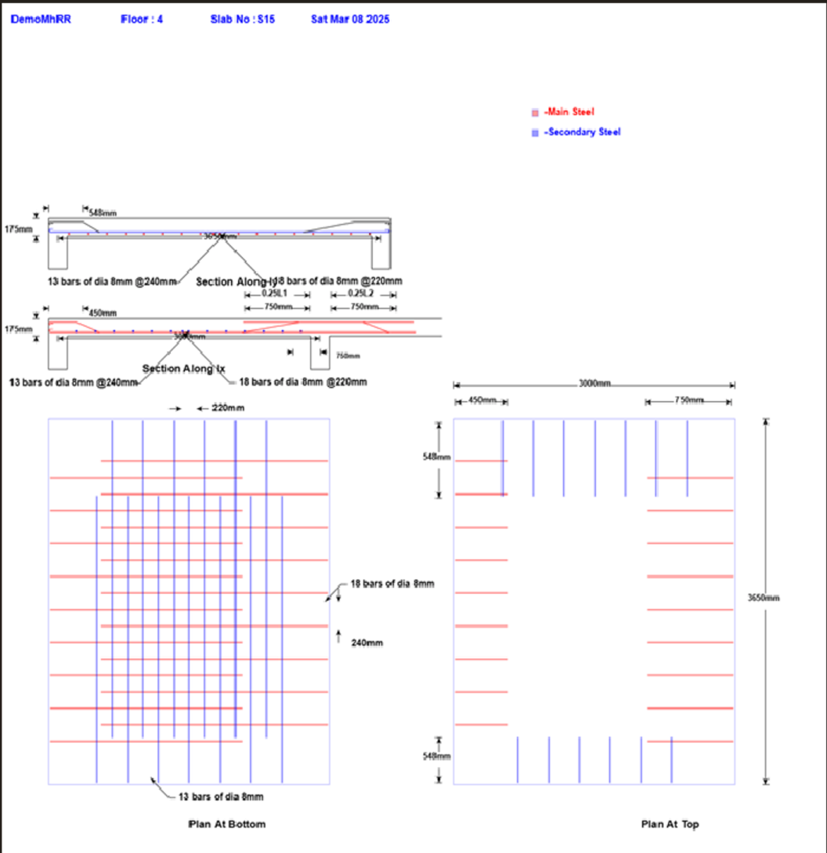
MvDad.com
Slab
Notes:
1

Slide 65
MvDad.com
Earthquake Drawings
Notes:
1

Slide 66
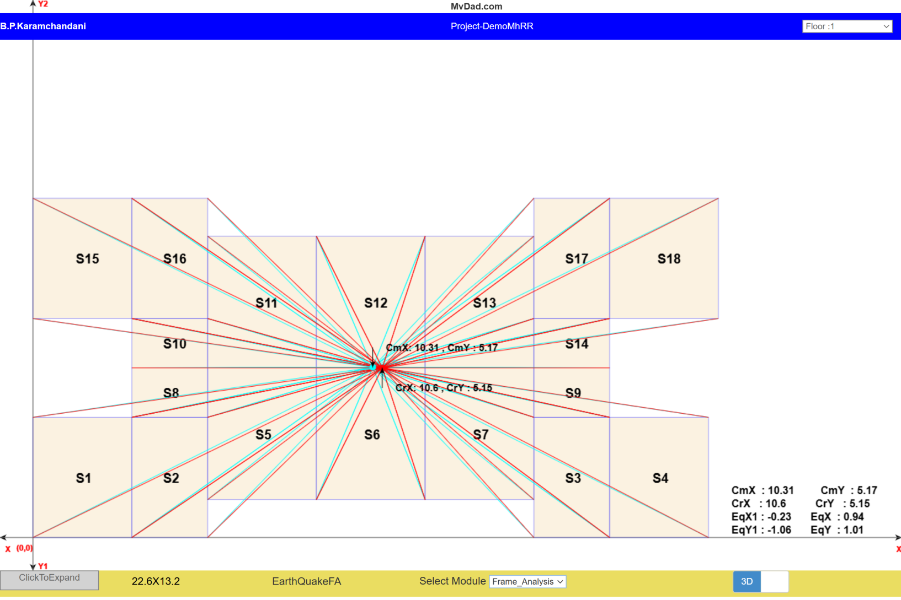
MvDad.com
Center of Mass and Center of Stiffness (Rigidity)
Notes:
1

Slide 67
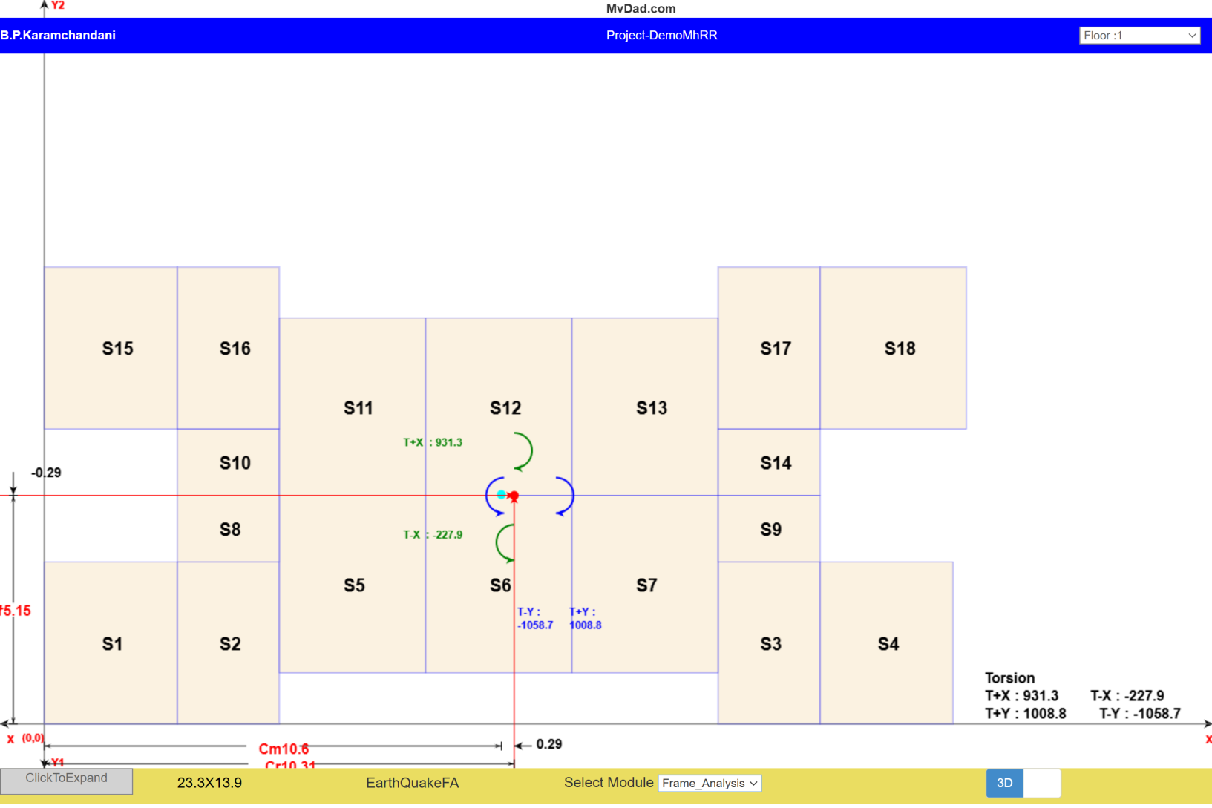
MvDad.com
Torsion
Notes:
1

Slide 68
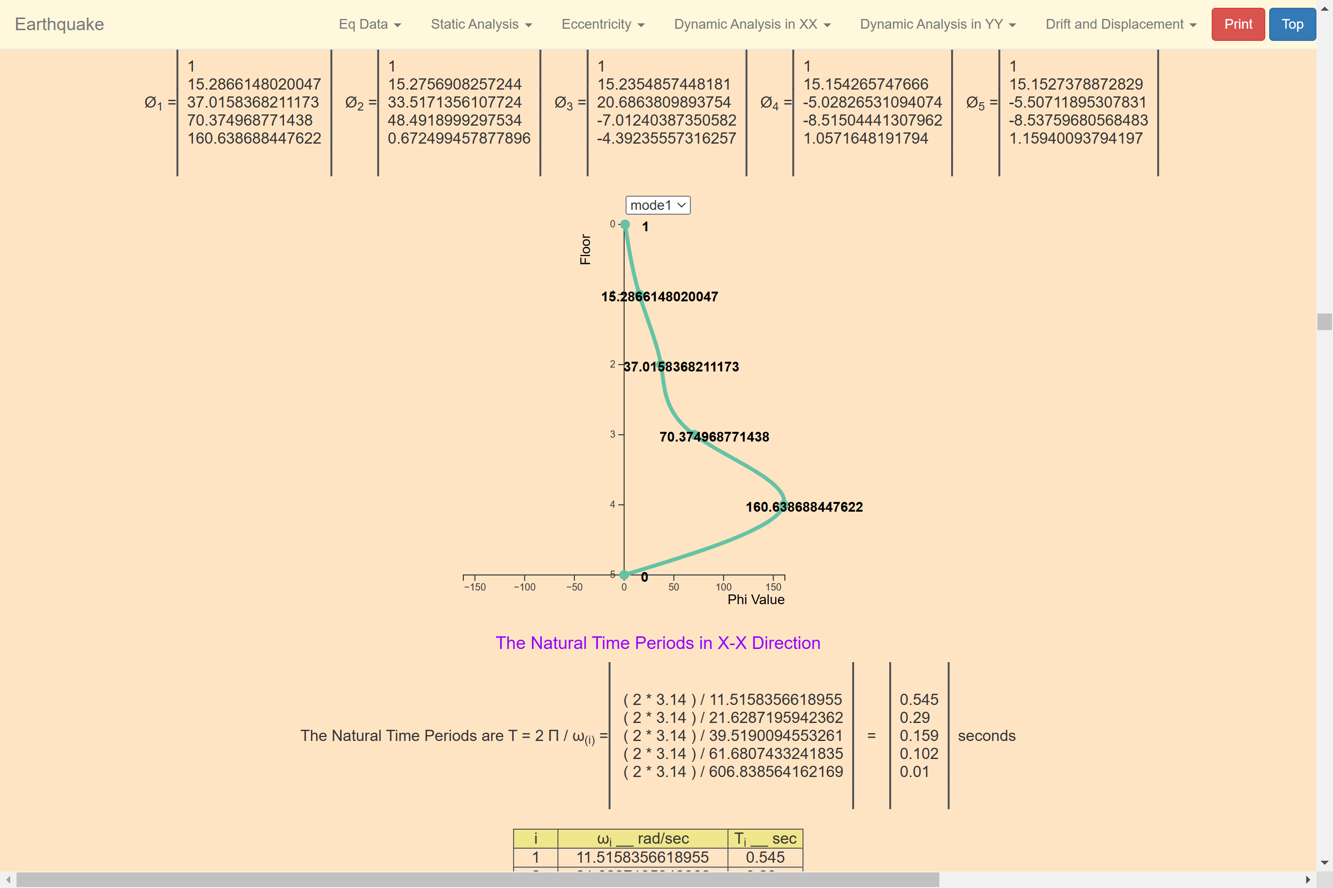
MvDad.com
Mode 1
Notes:
1

Slide 69
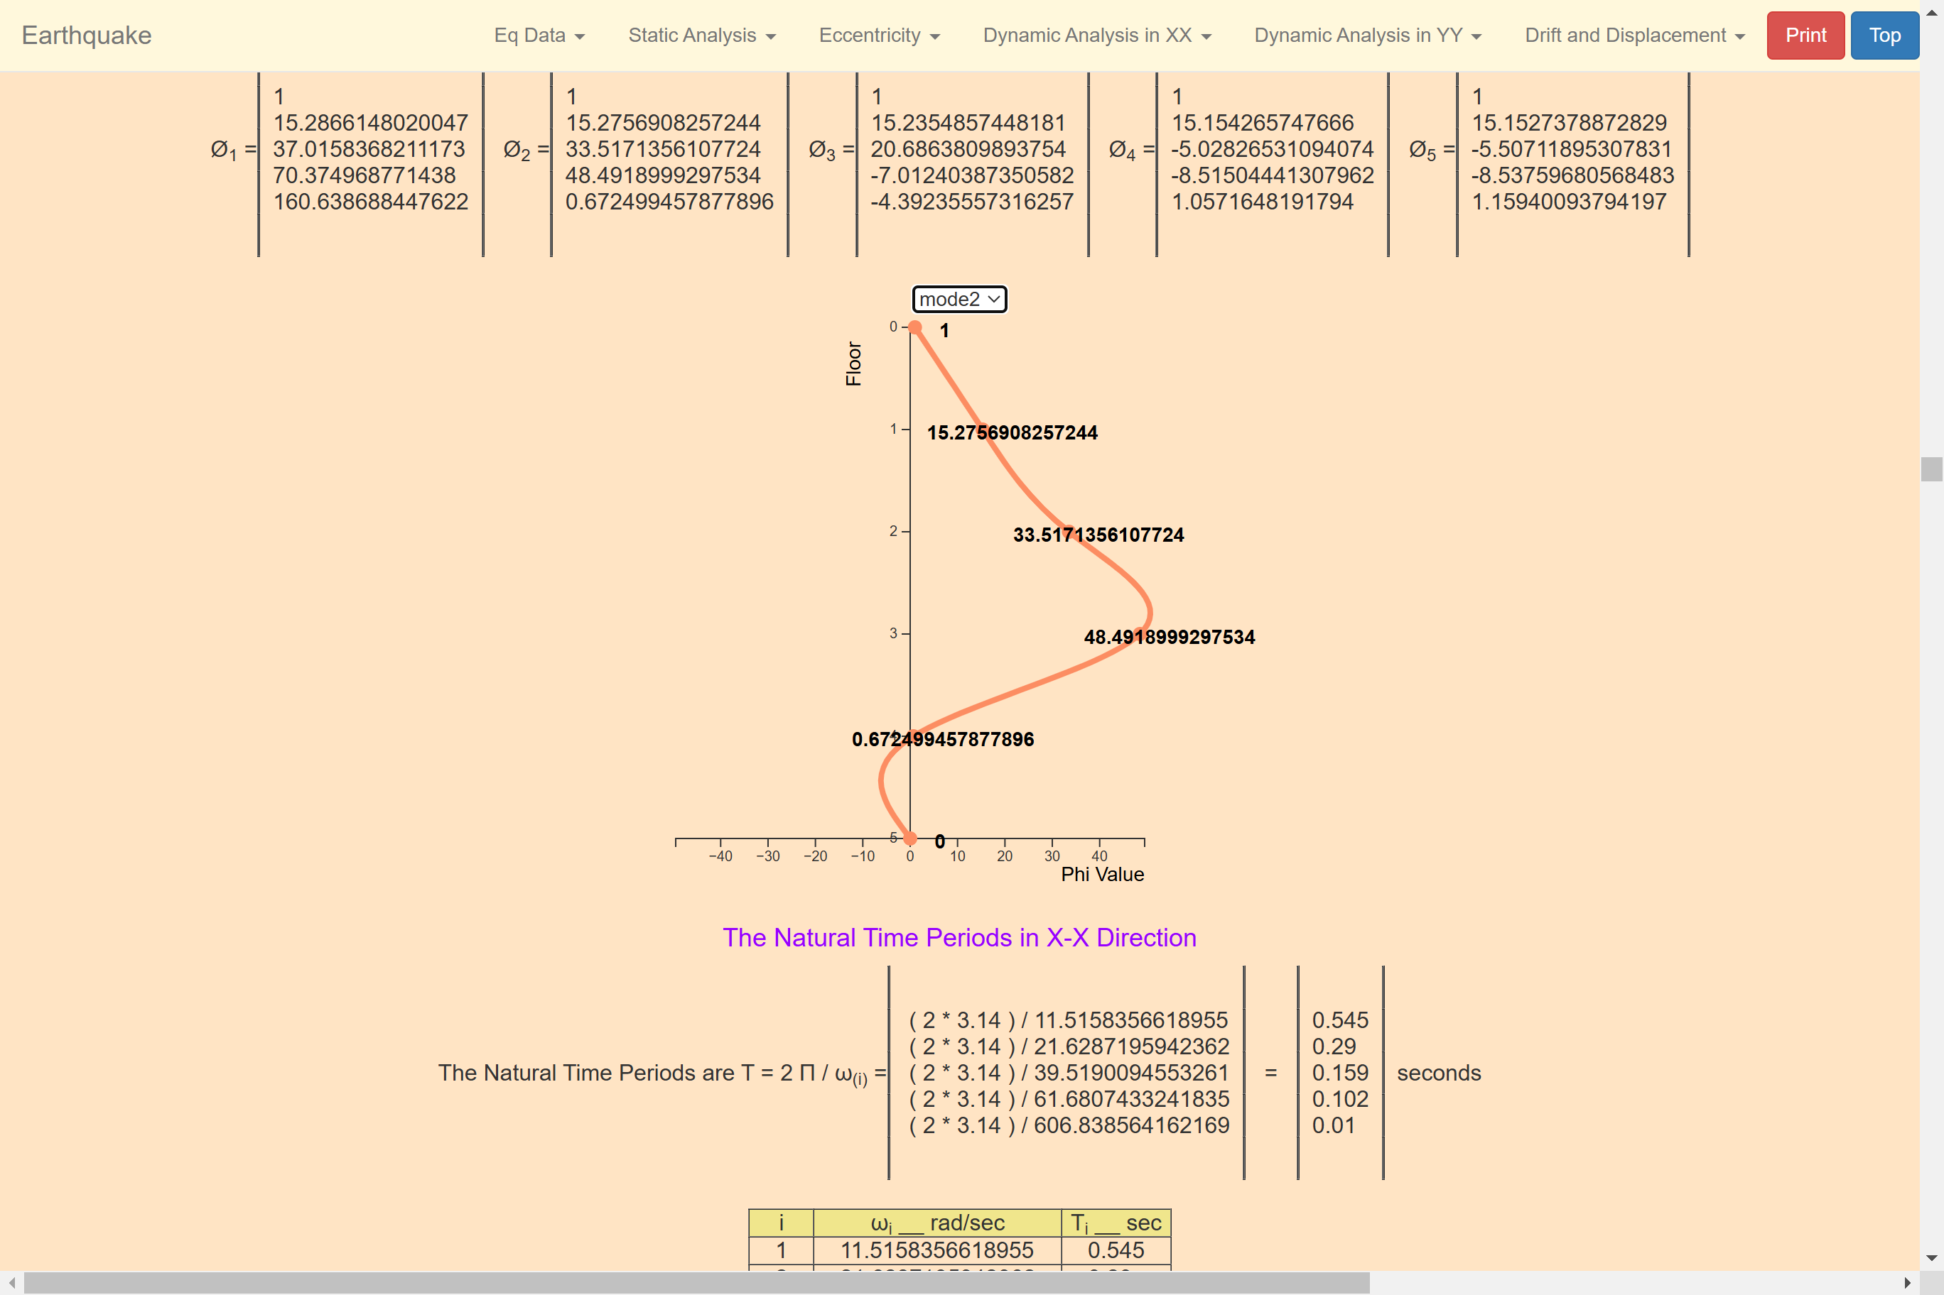
MvDad.com
Mode 2
Notes:
1

Slide 70
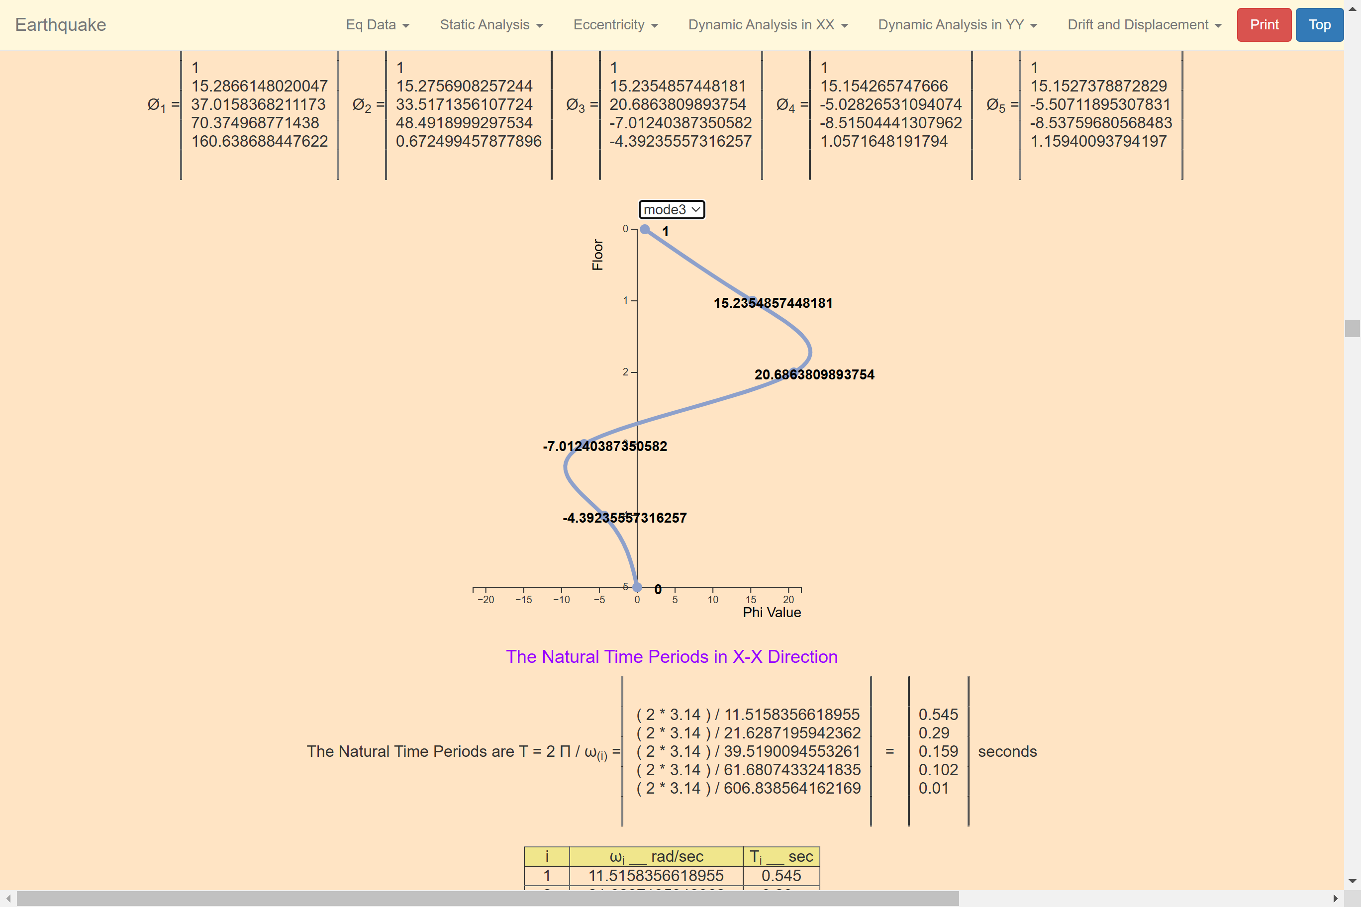
MvDad.com
Mode 3
Notes:
1

Slide 71
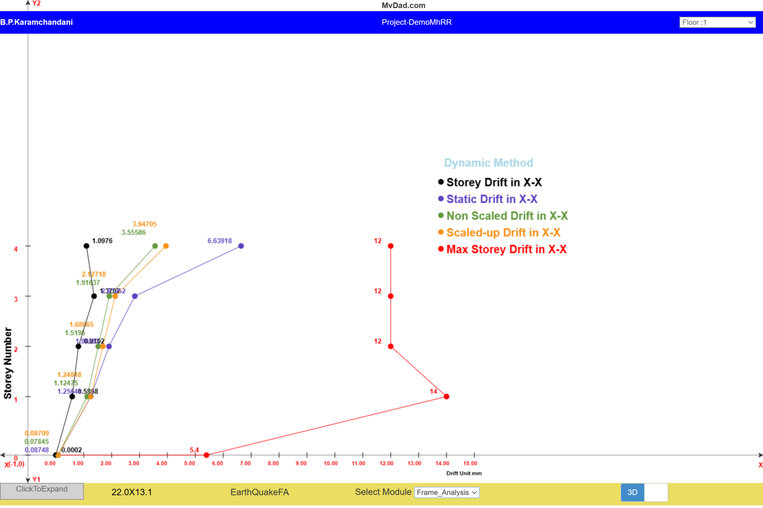
MvDad.com
Drift
Notes:
1

Slide 72
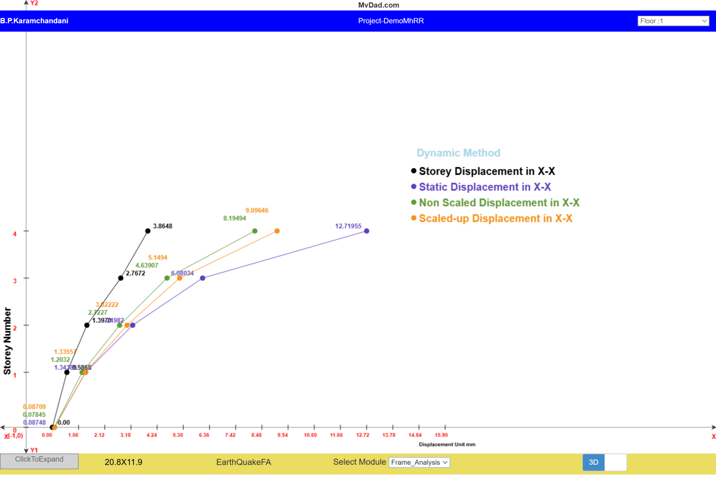
MvDad.com
Displacement
Notes:
1

Slide 73
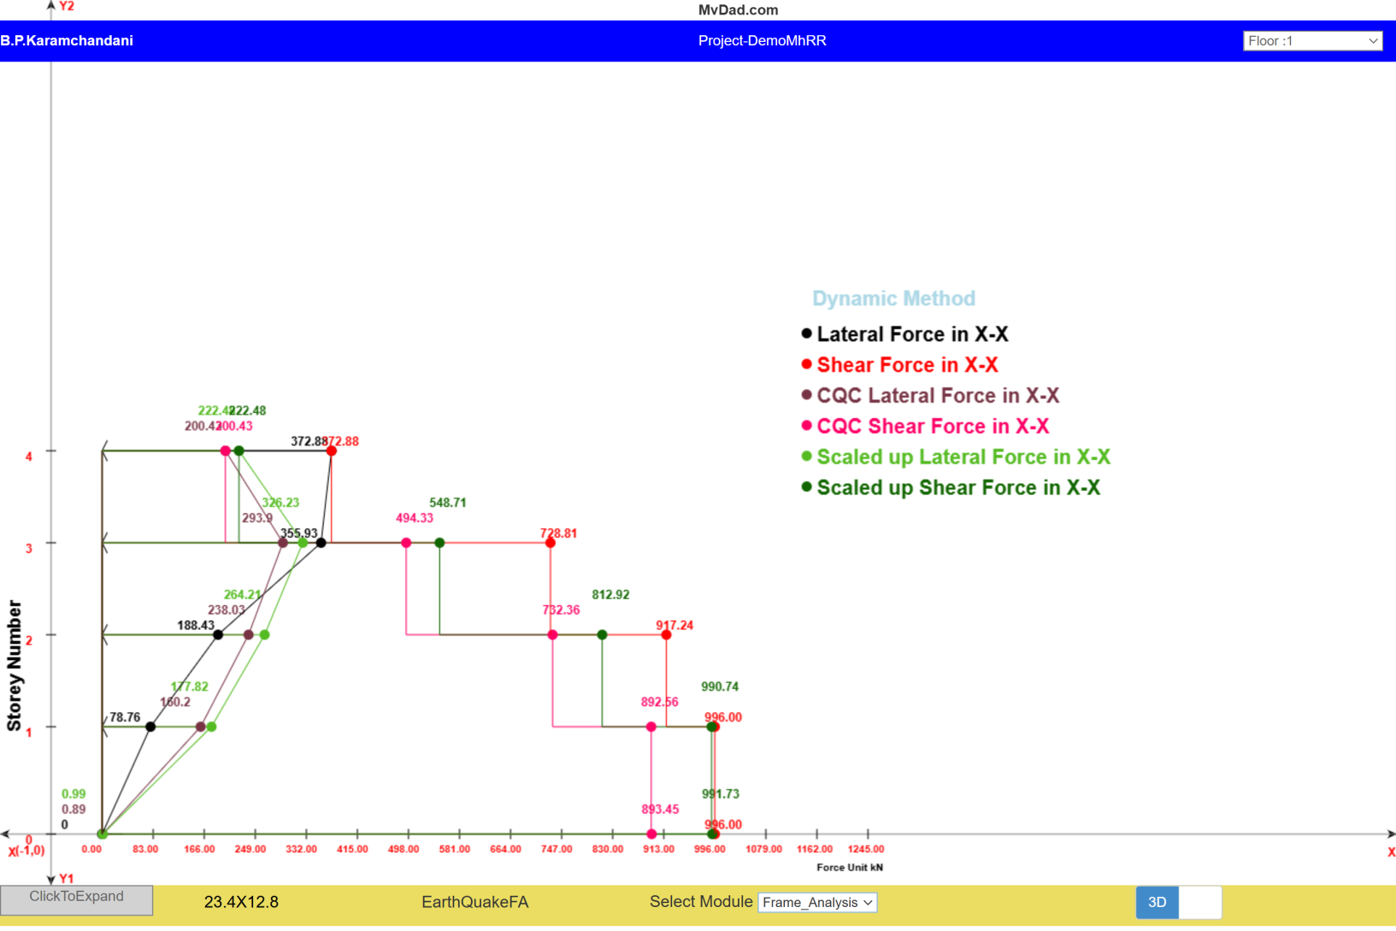
MvDad.com
Lateral Force and Shear Force
Notes:
1

Slide 74
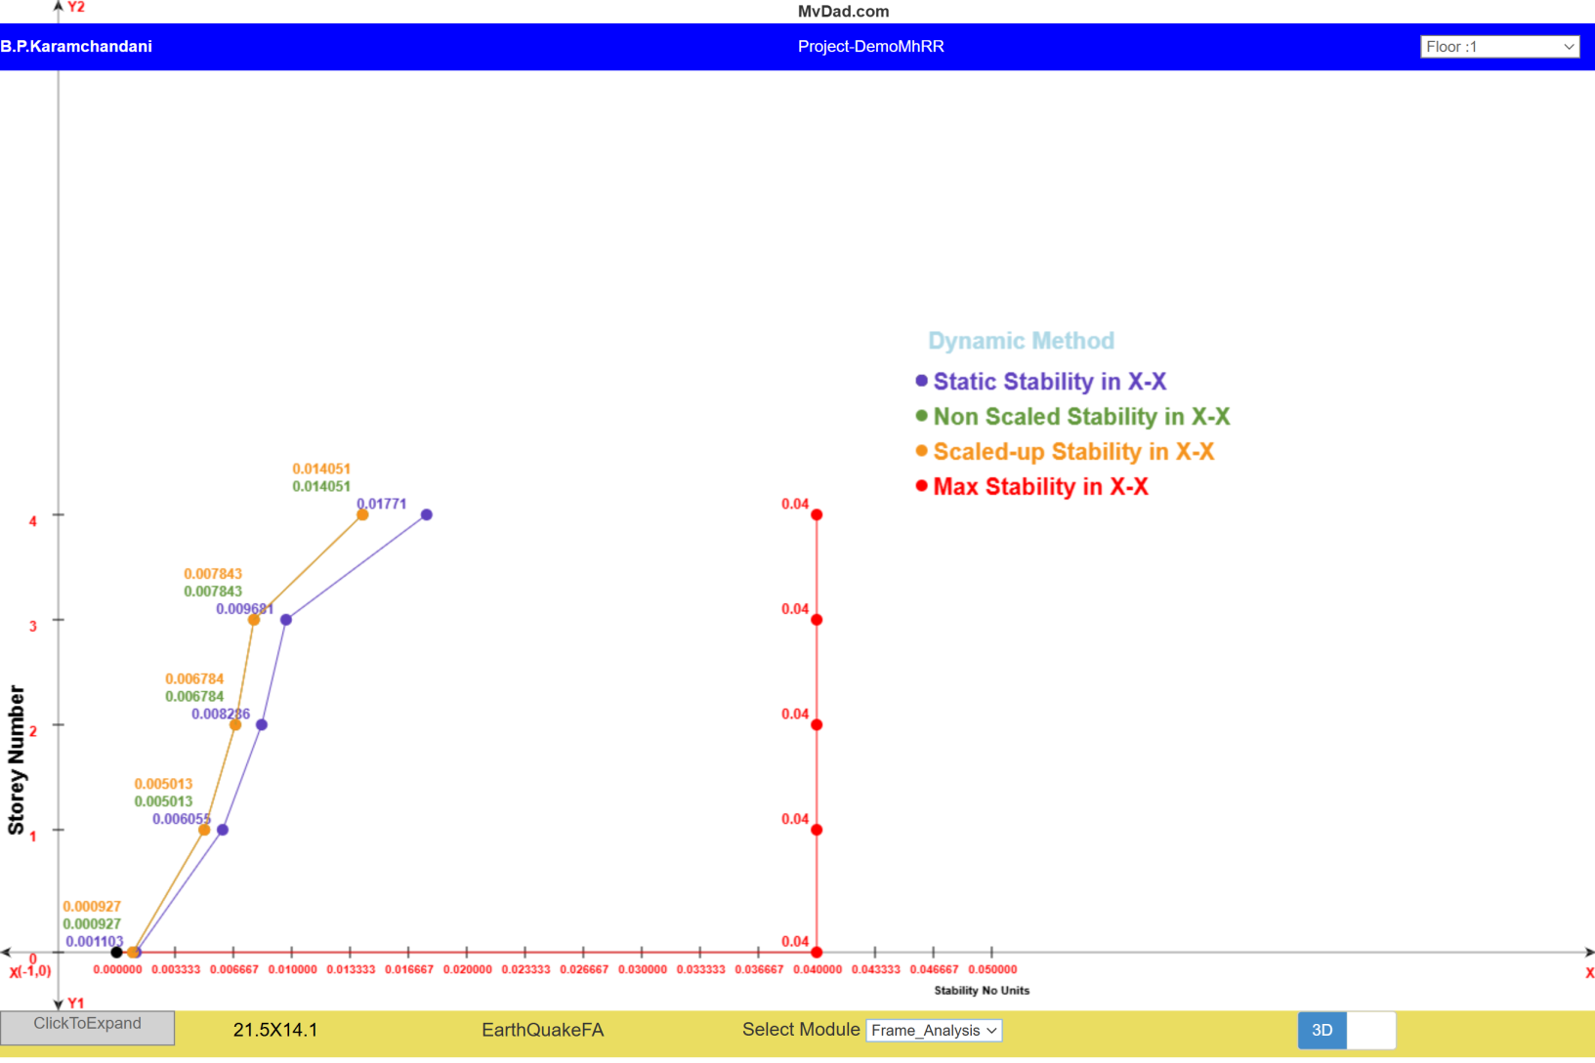
MvDad.com
Stability
Notes:
1

Slide 75
MvDad.com
Bill of Quantity
Notes:
1

Slide 76
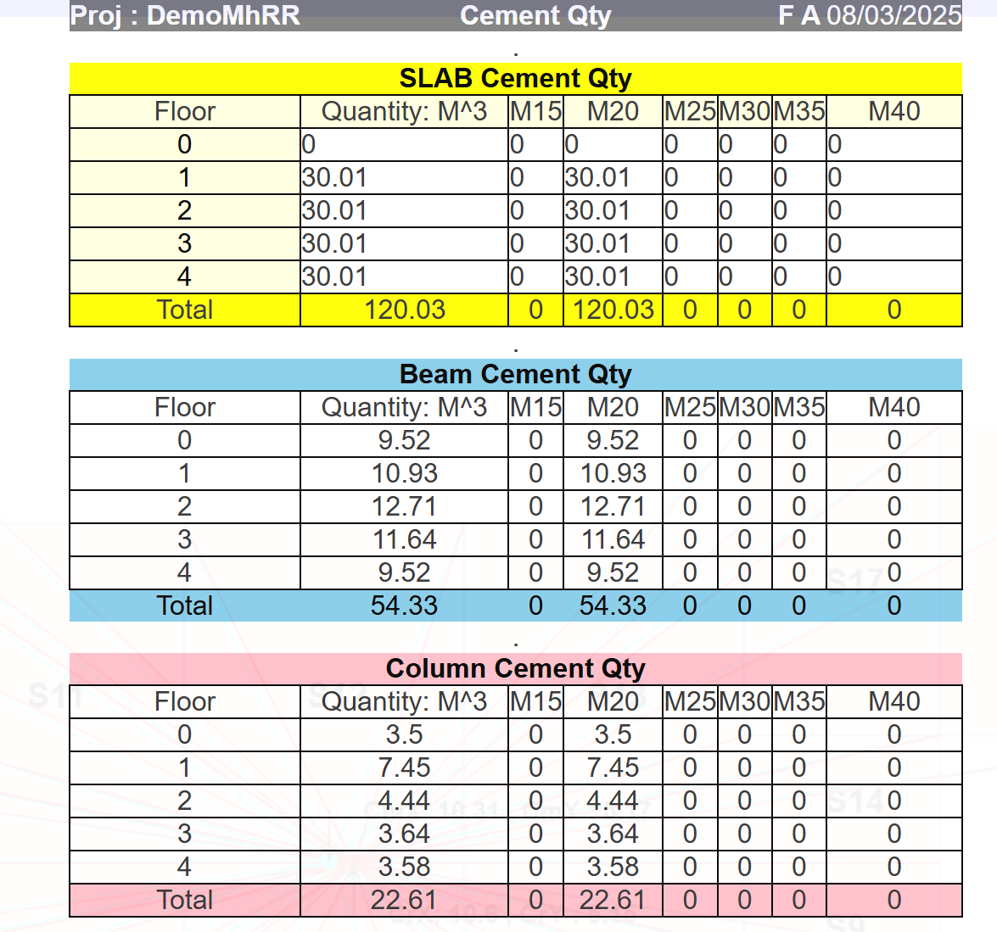
MvDad.com
Cement BOQ Modulewise
Notes:
1

Slide 77
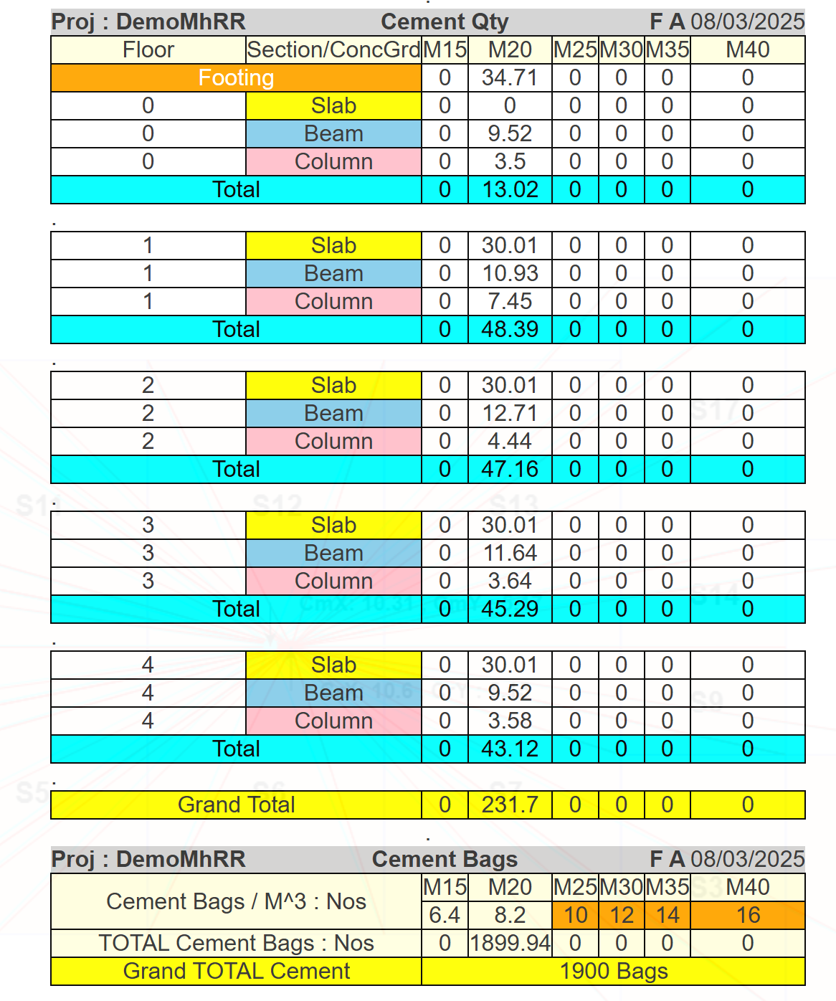
MvDad.com
Cement BOQ Floorwise
Notes:
1

Slide 78
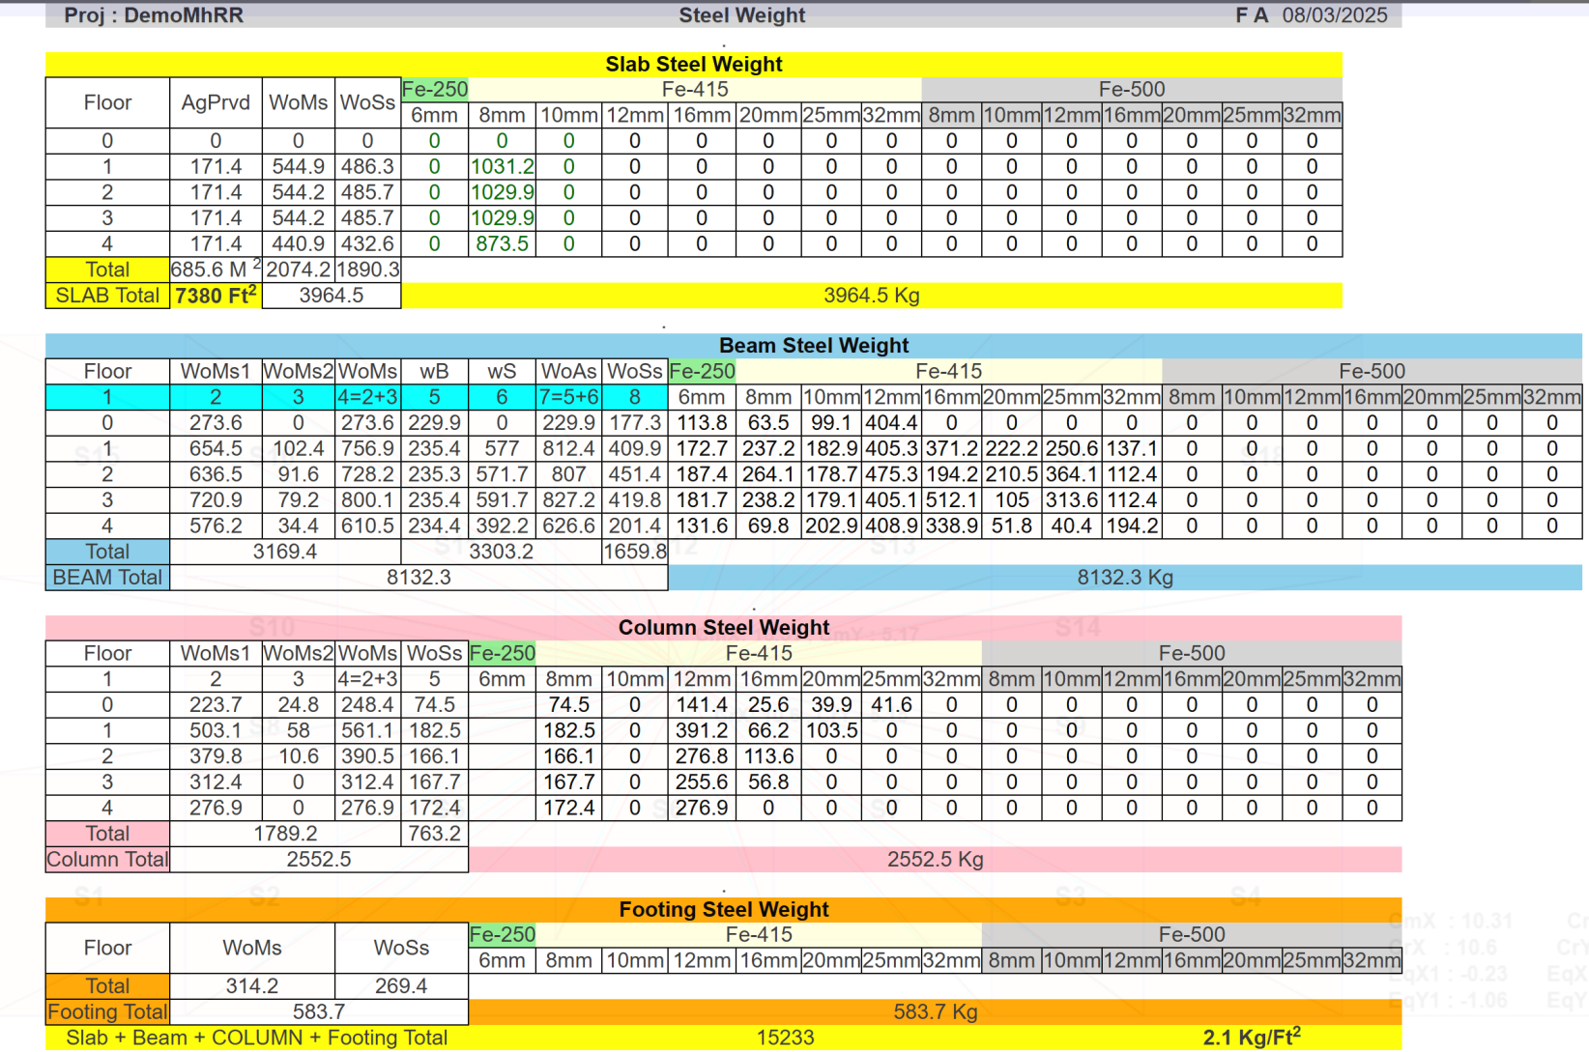
MvDad.com
Steel BOQ Modulewise
Notes:
1

Slide 79
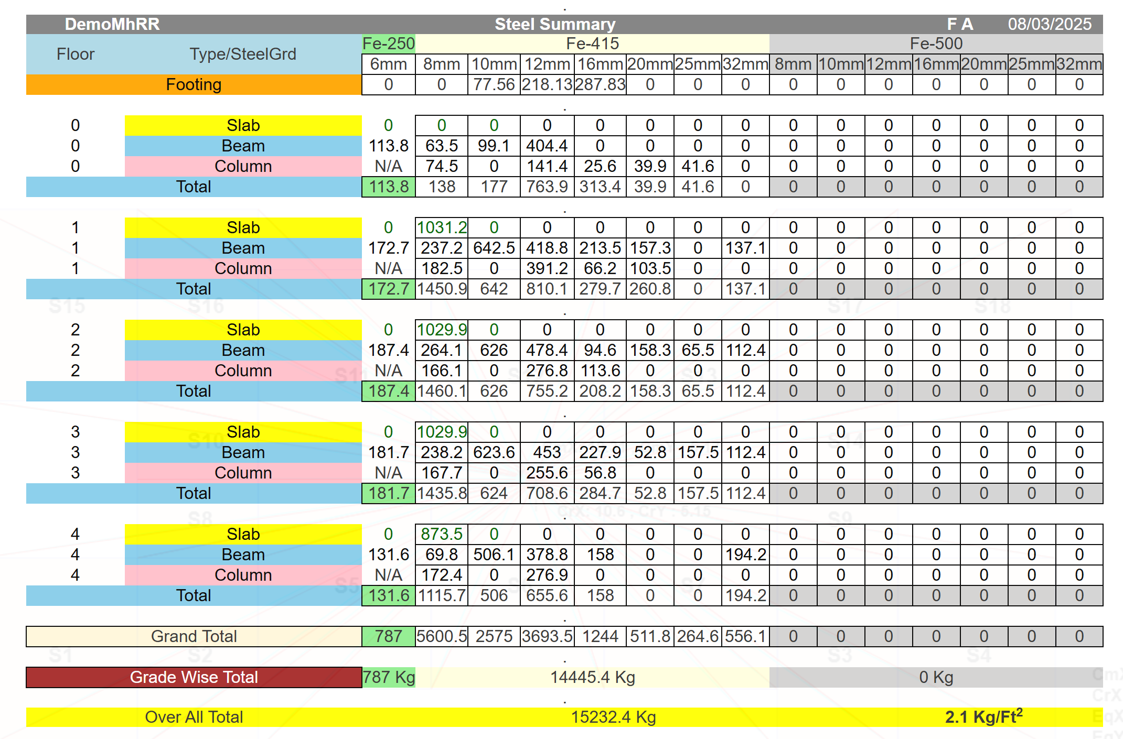
MvDad.com
Steel BOQ Floorwise
Notes:
1

Slide 80
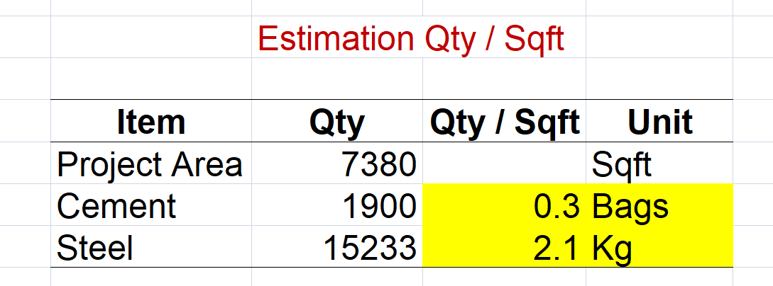
MvDad.com
Estimation
Notes:
1

Slide 81
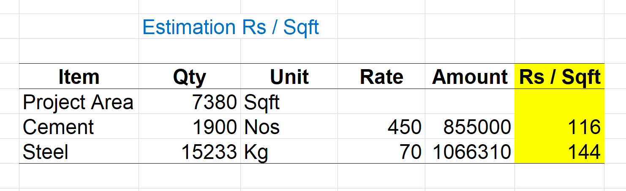
MvDad.com
Estimation
Notes:
1

Slide 82
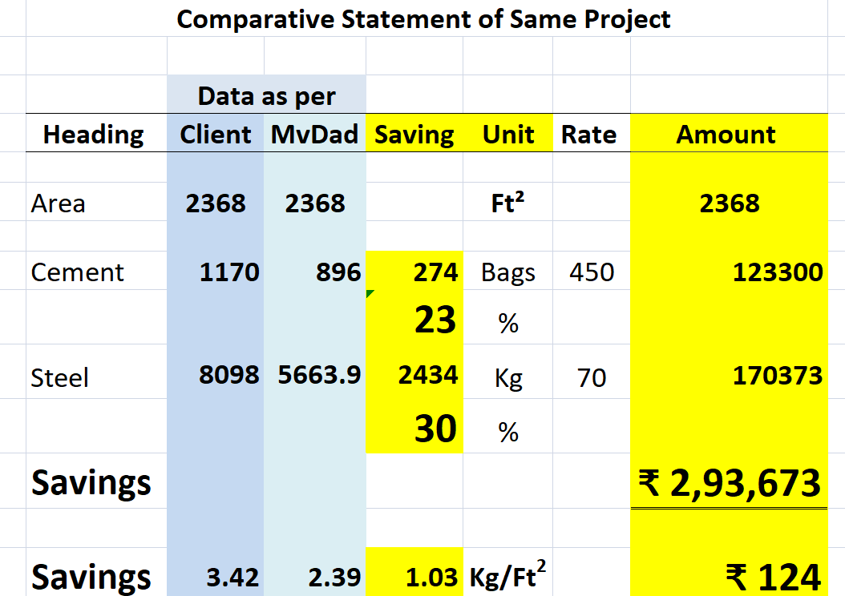
MvDad.com
Case Study
Notes:
1

Slide 83
MvDad.com
Conclusion
Anyone can Create New Project within 10 Minutes from anywhere
Most Optimise Design to provide Sustainable Stable Structural Solution
Share
Notes:
1

Slide 84
MvDad.com
We are open to Collaborate
Notes:
1

Slide 85
MvDad.com
We are open to Collaborate
  A. With Colleges
  Offering FREE Login Access of Exclusive Project for Students Education Purposes.
  74+ Seminars / Webinars Conducted across Bharat
  B. With Professionals
Notes:
1

Slide 86



MvDad.com
Sustainable Stable Structural Solutions
Cloud Based RC Building Earthquake Resistant Structural Design Software.
Thank You
Tutorial Feedback
Notes:
1

